Slide 1

Strengthening Heart Disease Prediction with CNN: Adversarial Robustness against Multiple Attacks
PROJECT ID : R24-102

Slide 2






OUR TEAM
Co-Supervisor
Supervisor
Ms. Chethana Liyanapathirana
Mr. Deemantha Siriwardana
Devindi Karandawala
Vihangi Yasuththara
Devmini Weerakoon
Savindhya Bandara

Slide 3

What led to this research?
Machine learning models are increasingly being adopted across various industries for predictive analysis, improving decision-making and operational efficiency.
Near 80% of businesses globally use machine learning and AI technologies as of 2024.
Machine learning model security is at risk due to the possibility of manipulation by harmful inputs, which can result in inaccurate predictions or classifications.
Attacks for ML models manipulate inputs or steal sensitive data, compromising model integrity and security.
This research specifically investigates the robustness of the Convolutional Neural Network (CNN) model against adversarial attacks and applies defenses against these attacks.
Resource: https://techjury.net/blog/ai-statistics/

Slide 4

INTRODUCTION
This research specifically investigates the robustness of the Convolutional Neural Network (CNN) model against four adversarial attacks.
  Projected Gradient Decent (PGD) Attack.
  Decision-based Boundary Attack.
  Carlini & Wagner(C&W) Attack.
  Brendel & Bethge (B&B) Attack.
Applied and tested defensive strategies against these attacks to robust the model.

Slide 5

Research problem
How can we make our model robust against these adversarial attacks?
What are the defense mechanisms that can we apply to make the model robust?

Slide 6

Research Question
Is the neural network model trained on tabular data sensitive to the selected adversarial attacks?
What mechanisms can be applied to make the model robust against these attacks?
IT21023514 | Karandawala D.N | R24-102

Slide 7

Main Objective
To assess and evaluate the effect of the above-mentioned adversarial attacks on our proposed model and attempt to increase model strength against the given attacks.

Slide 8
Sub Objectives
Build a neural network model with high accuracy for a Heart disease dataset.
Apply adversarial attacks against the model to identify changes in accuracy and evaluate the extent of the attack's impact by comparing accuracies.
Identify and test defense mechanisms to make the model robust against the said attacks.
Build a system that allows a user to input a model that will be tested against the attack and suggest methods to make the model robust if the model is affected.

Slide 9
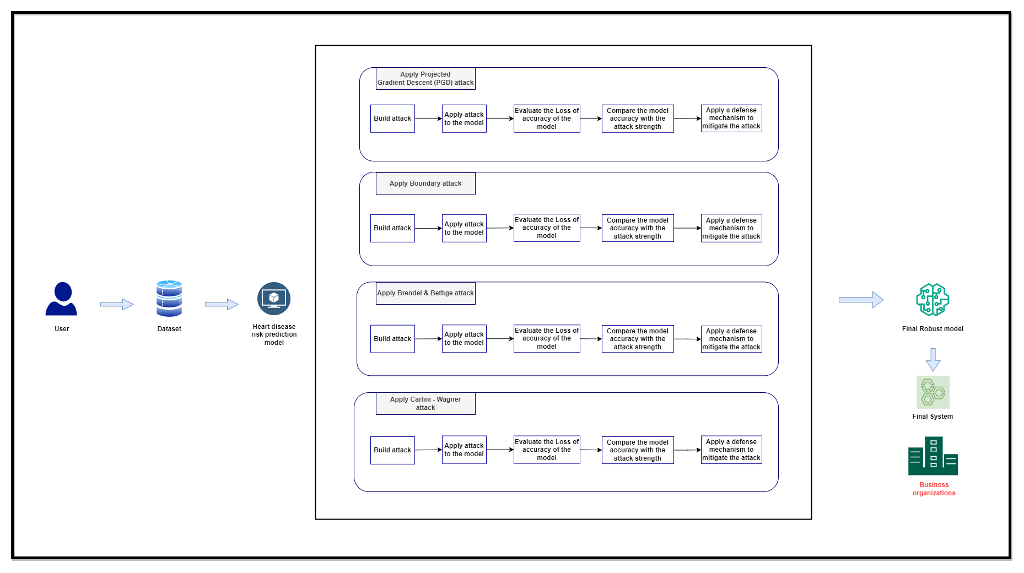
System Diagram

Slide 10

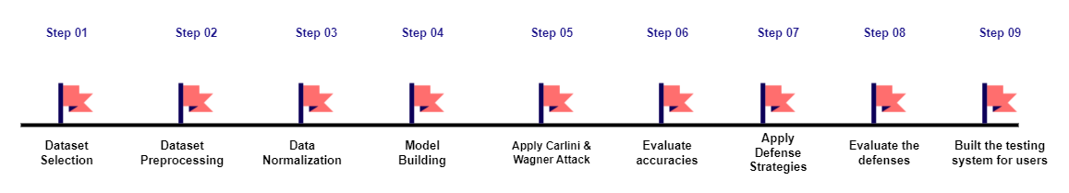
Completion of the Project

Slide 11
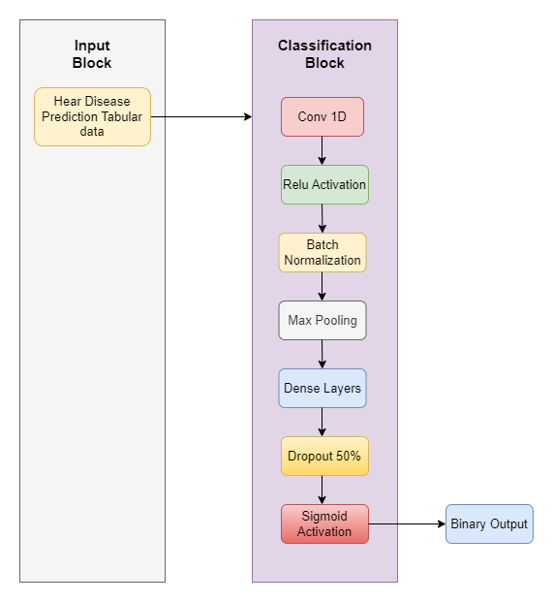
MODEL IMPLEMENTATION - CNN
Dataset: Cardiovascular Disease Risk Prediction Dataset
Data preprocessing:
  Exploratory Data Analysis (EDA)
  Feature Identification and Categorization
  Feature Selection (Based on Cardiologist expert opinion)
  Data Balancing (SMOTE & Random under sampling combination)
Model Architecture: CNN
  Optimizer used – Adam
  Binary cross entropy loss function was used for training
  Activation Functions – Relu , Sigmoid
Training Accuracy: 76%
Testing Accuracy: 81%

Slide 12
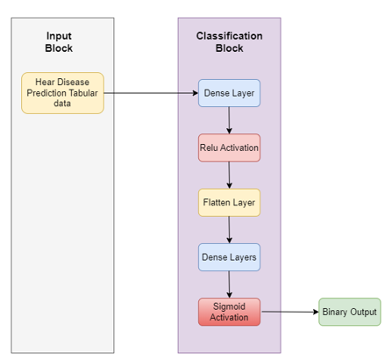
MODEL IMPLEMENTATION - DNN
Dataset: Cardiovascular Disease Risk Prediction Dataset
Data preprocessing:
  Exploratory Data Analysis (EDA)
  Feature Identification and Categorization
  Feature Selection (Based on Cardiologist expert opinion)
  Data Balancing (SMOTE & Random under sampling combination)
Model Architecture: DNN
  Optimizer used – Adam
  Binary cross entropy loss function was used for training
  Activation Functions – Relu, Sigmoid
Training Accuracy: 79%
Testing Accuracy: 76%

Slide 13
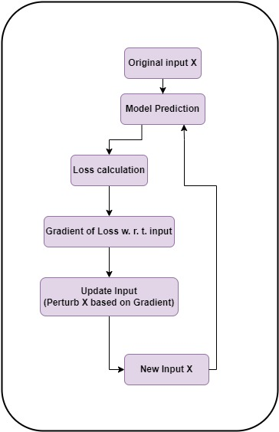
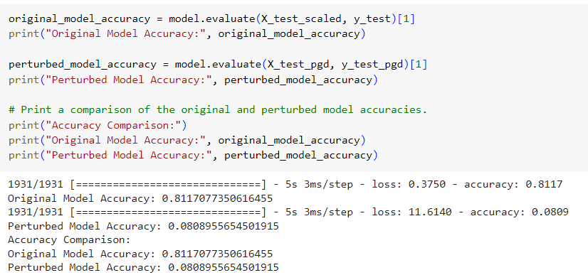
ADVERSARIAL ATTACKS – CNN Model
Project Gradient Descent Attack
Testing
Train CNN Model
Apply Attack in Test Phase

Slide 14
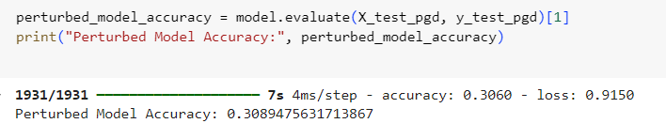
ADVERSARIAL ATTACKS – DNN Model
PROJECT GRADIENT DECENT ATTACK
Testing
Train DNN Model
Apply Attack in Test Phase

Slide 15
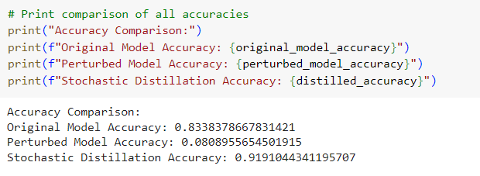
Defense on PGD Attack
Defense Type | Description | Results of Applying Defense
Stochastic Distillation | Uses a custom loss function called stochastic_distillation_loss to train a machine learning model as a regularization technique during training Stochastic distillation is a technique where the model's predictions are "softened" using a temperature parameter By softening the predictions, stochastic distillation introduces noise into the training process. This noise can act as a form of regularization, preventing the model from fitting too closely to the training data | Model accuracy after attack: 8.08% Model accuracy after defense 91.9%

Slide 16
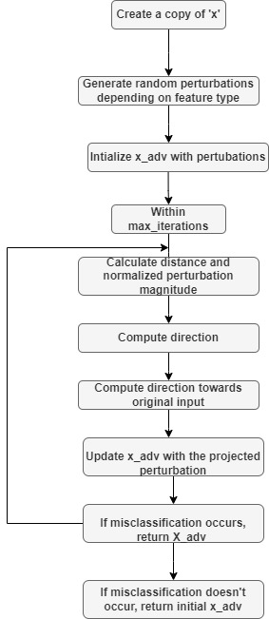
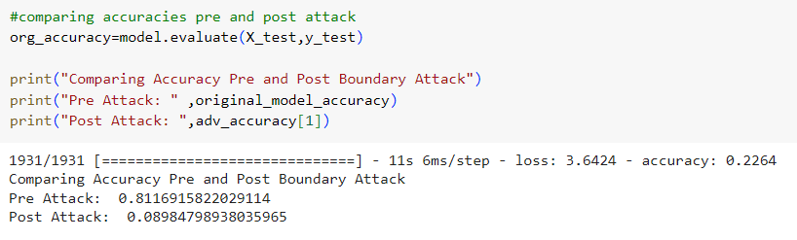
ADVERSARIAL ATTACKS – CNN Model
Tabular Boundary Attack
Train CNN Model
Apply Attack in Test Phase

Slide 17
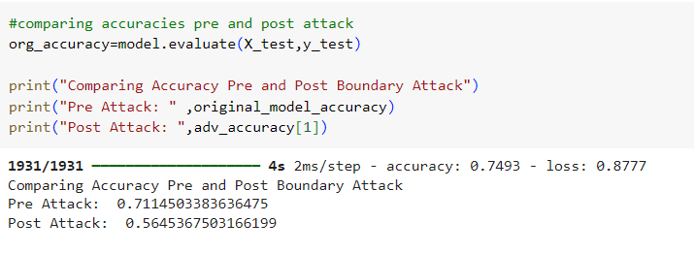
ADVERSARIAL ATTACKS – DNN Model
Tabular Boundary Attack
Train DNN Model
Apply Attack in Test Phase

Slide 18
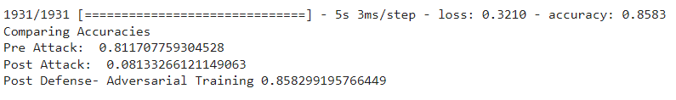

Defense on Boundary Attack
Defense Type | Description | Results of Applying Defense
Adversarial Training | Include adversarial examples to train model. Here, model is trained with 100 additional adversarial samples | Original Model Accuracy : 81.1% Model Accuracy after Attack:8.1% Model Accuracy after Defense:85.8%
Ensemble Model | -Original CNN model is combined with two more models a MLP model and Wide & Deep Neural Network Model An ensemble model is formed with all three models | Ensemble Model Accuracy=80% Ensemble Model After Attack=76.3%

Slide 19
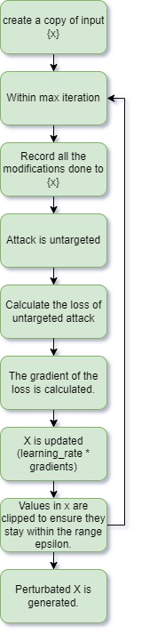
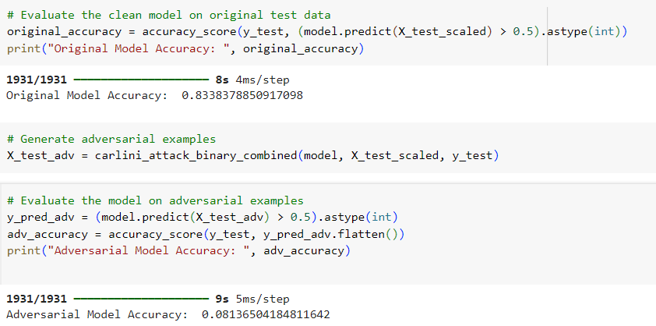

ADVERSARIAL ATTACKS – CNN Model
Carlini Attack
Testing
Train CNN Model
Apply Attack in Test Phase

Slide 20
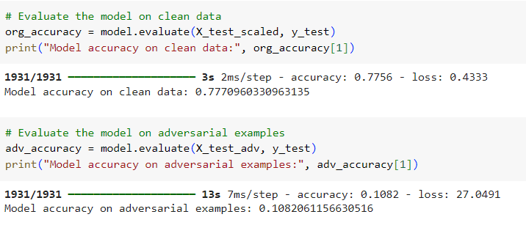
ADVERSARIAL ATTACKS – DNN Model
Carlini Attack
Testing
Train DNN Model
Apply Attack in Test Phase

Slide 21
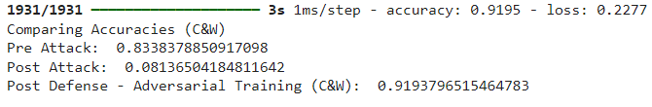
Defense on Carlini & Wanger Attack
Defense Type | Description | Results of Applying Defense
Adversarial Training | Divide the training data into batches(batch size=100). Apply the attack to generate perturbated batches. Combine both clean and perturbated batches. Train the model using this data set which provide the model the ability to identify perturbated data. | Original Accuracy- 0.833 Accuracy after defense -0.919
Adversarial Training

Slide 22
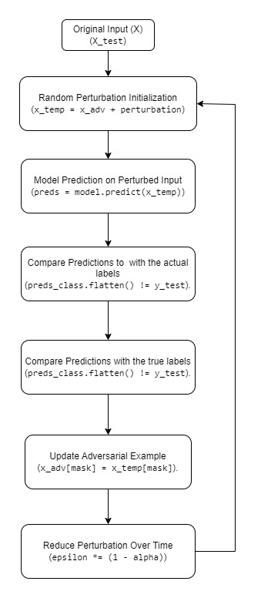
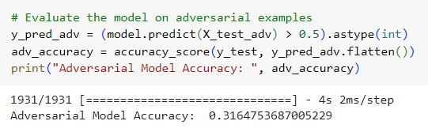
ADVERSARIAL ATTACKS – DNN Model
Brendel & Bethge Attack
Testing
Train CNN Model
Apply Attack in Test Phase

Slide 23
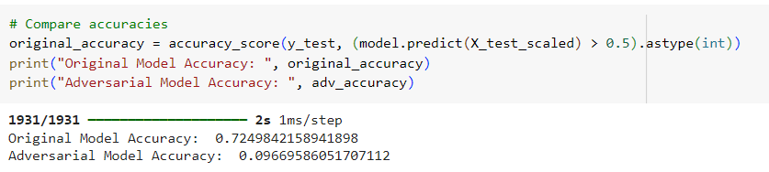
ADVERSARIAL ATTACKS – DNN Model
Brendel & Bethge Attack
Testing
Train DNN Model
Apply Attack in Test Phase

Slide 24
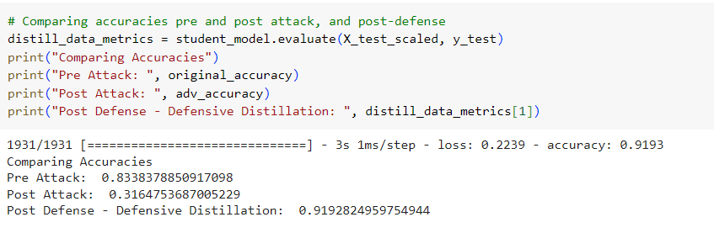
Defense on Carlini & Wanger Attack
Defense Type | Description | Results of Applying Defense
Defensive Distillation | Train a teacher model(CNN) and obtain the softened labels and temperatures. Train a student model(CNN) using these temperatures and softened labels which is more robust. | Original Accuracy- 0.833 Accuracy after defense -0.919
Defensive Distillation

Slide 25

Defense Strategies
With relevance to the selected attacks, the following defense strategies were identified and tested to make our model robust.
      Adversarial Training
      Stochastic Distillation
      Defensive Distillation
      Ensemble Model With Squeezed Features

Slide 26

SYSTEM IMPLEMENTATION

Slide 27

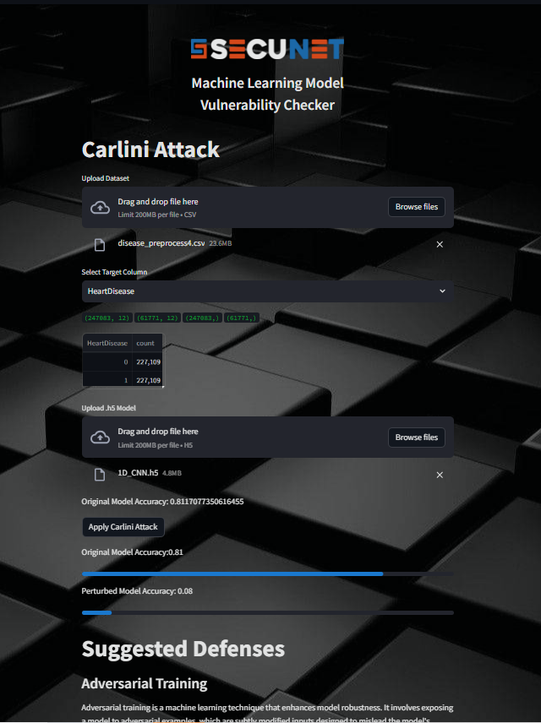
SYSTEM IMPLEMENTATION
Boundary Attack
Carlini Attack

Slide 28

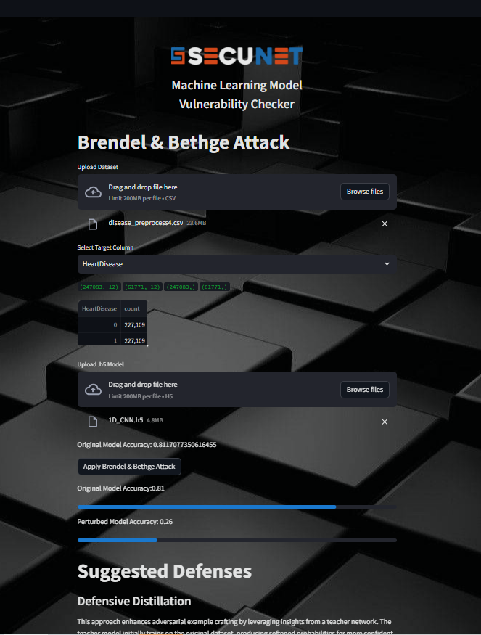
SYSTEM IMPLEMENTATION
PGD Attack
Brendel & Bethge Attack

Slide 29
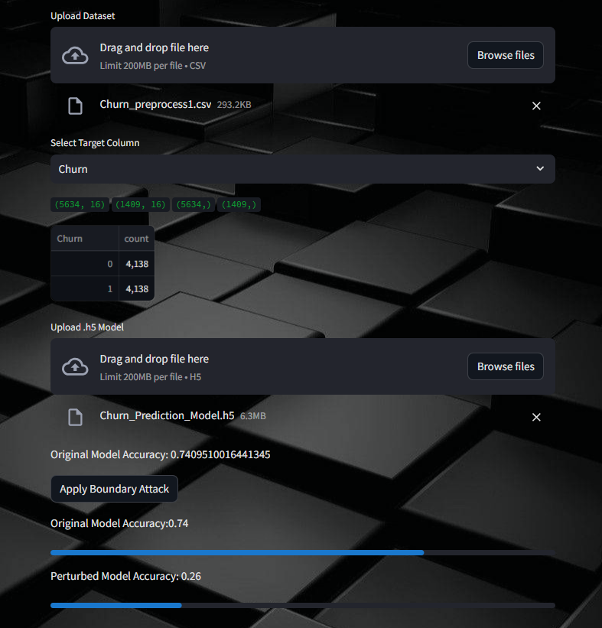
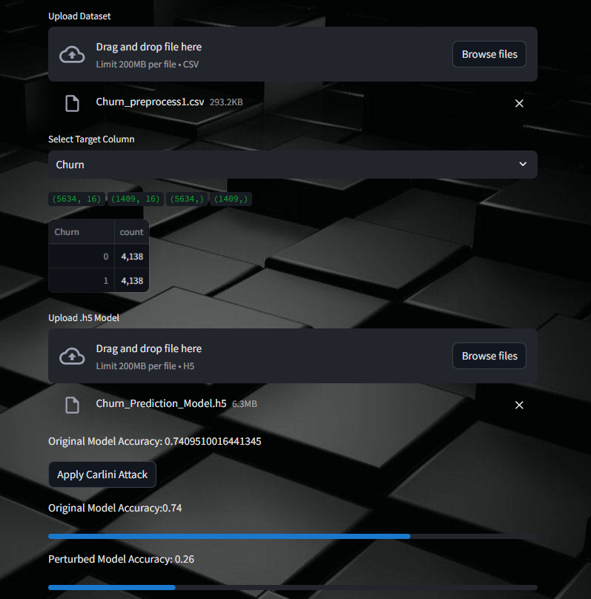
TEST ON OTHER MODELS
Boundary Attack
Carlini Attack

Slide 30
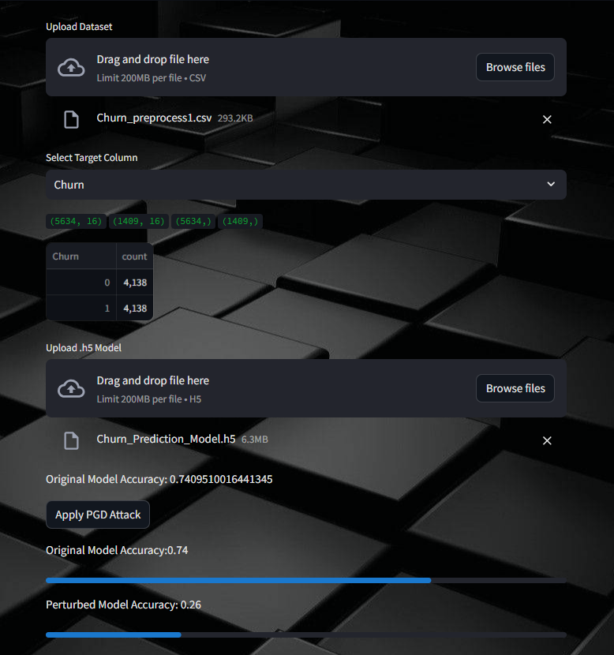
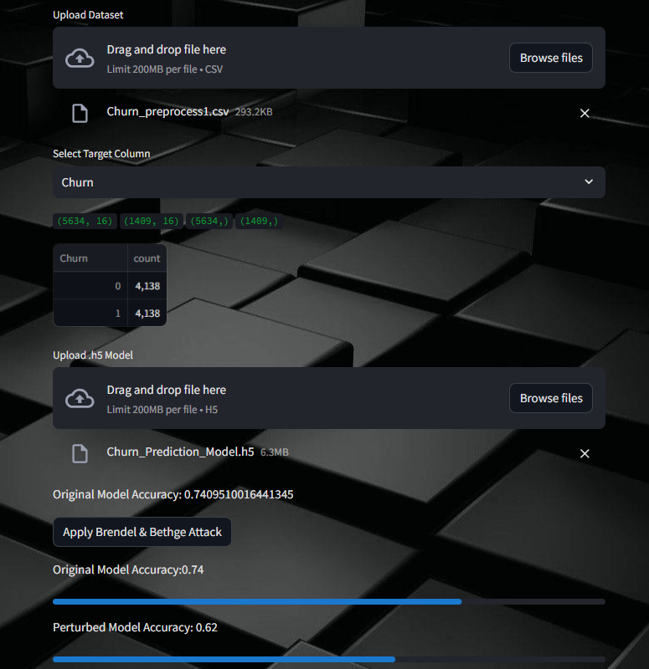
TEST ON OTHER MODELS
PGD Attack
Brendel & Bethge Attack

Slide 31


Deployed System
Frontend
Streamlit
Deployment
Streamlit Cloud

Slide 32





Tools and Technologies
Technologies
Development - Python
Building model – Conda Notebook, Google Colab , Visual Studio
Technology stack:
Version controlling – GitLab
Algorithm
CNN
Feed forward algorithm
Libraries
Scikit-learn ,TensorFlow
Art (Adversarial robustness toolbox)
Matplotlib, Numpy, Pandas,Keras
Stream Lit

Slide 33

Commercialization
Evaluates resilience of a model against Adversarial Attacks
Test and suggest Defenses
Ensure safety and security of ML odels
Demand
Increasing use of ML models for various tasks
Increasing adversarial attacks against strategies against ML models
Users
Features
Data scientists and analysts
ML Developers and Researchers
Security Experts
Enterprises and Organizations
Notes:
For the commercialization we identified users, features and demand

Slide 34
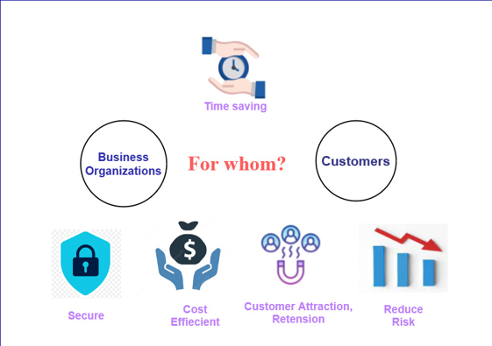

Slide 35

Questions?

Slide 36
THANK YOU

