Slide 1

Strengthening Heart Disease Prediction with CNN: Adversarial Robustness against Multiple Attacks
PROJECT ID : R24-102

Slide 2

Team Members
Supervisor – Ms. Chethana Liyanapathirana
Co-Supervisor – Mr. Deemantha Siriwardana
Student Name | Student ID
Karandawala D.N | IT21023514
Yasuththara B.G.V | IT20172282
Weerakoon R. A. D. D. C | IT21068164
Bandara W H M T S | IT21027642

Slide 3
CONTENT
INTRODUCTION AND BACKGROUND
RESEAECH PROBLEM
PROJECT OBJECTIVES
RESEARCH COMPONENTS
COMMECIALZATION
SYSTEM DIAGRAM

Slide 4
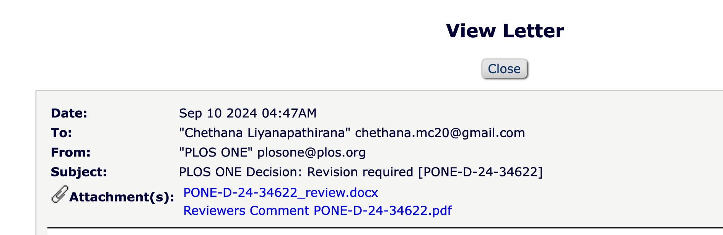
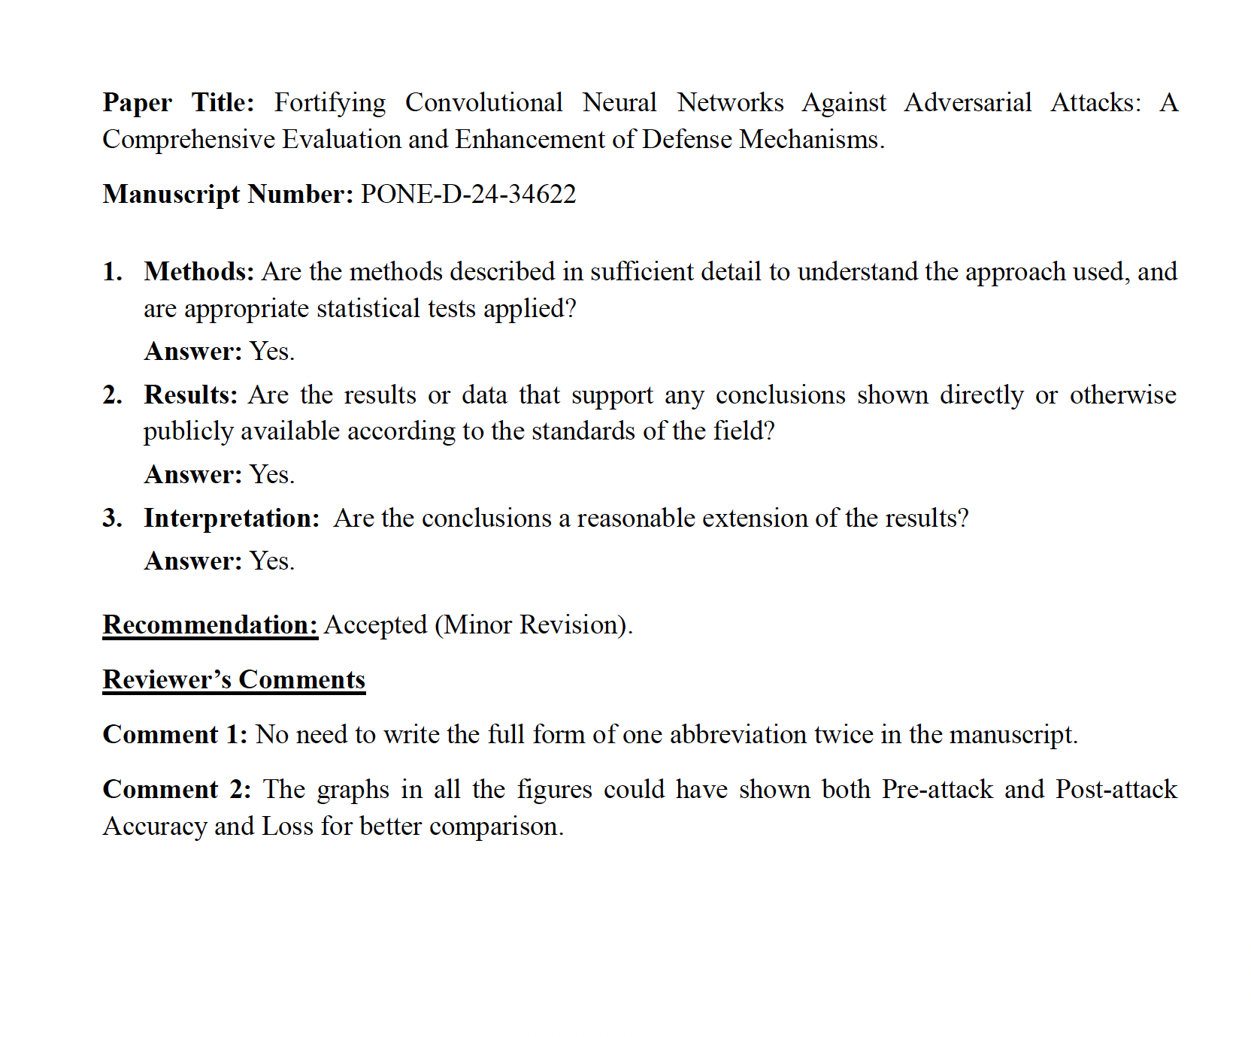
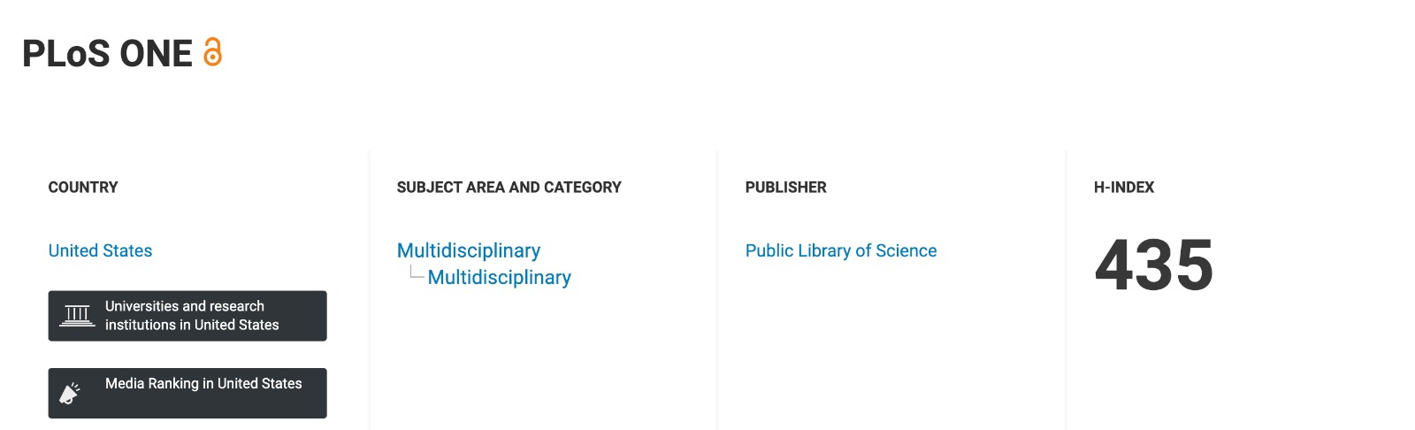
Q1 - Journal Acceptance with Minor review

Slide 5




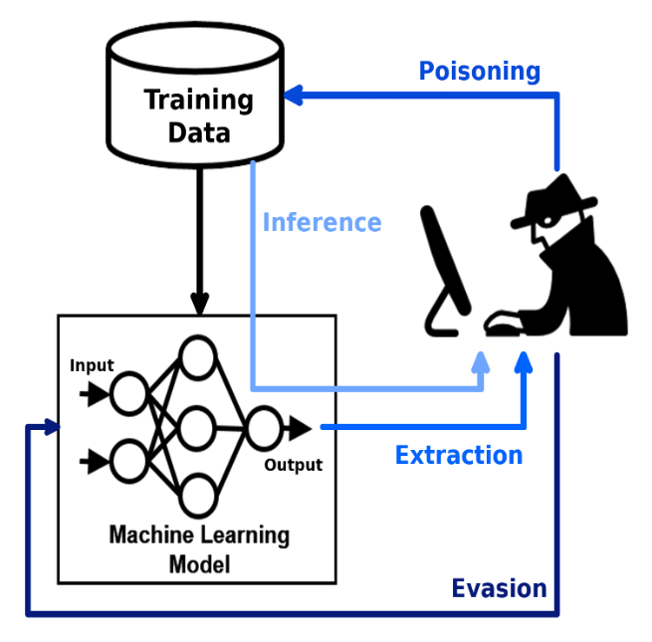
Introduction
Machine learning models are increasingly being adopted across various industries for predictive analysis, improving decision-making and operational efficiency.
Near 80% of businesses globally use machine learning and AI technologies as of 2024.
Machine learning model security is at risk due to the possibility of manipulation by harmful inputs, which can result in inaccurate predictions or classifications.
Attacks for ML models manipulate inputs or steal sensitive data, compromising model integrity and security.
This research specifically investigates the robustness of the Convolutional Neural Network (CNN) model against adversarial attacks and applies defenses against these attacks.
Resource: https://techjury.net/blog/ai-statistics/

Slide 6

Research problem
How can we make our model robust against these adversarial attacks?
What are the defense mechanisms that can we apply to make the model robust?

Slide 7

Main Objective
To assess and evaluate the effect of the above-mentioned adversarial attacks on our proposed model and attempt to increase model strength against the given attacks.

Slide 8
Sub Objectives
Build a neural network model with high accuracy for a Heart disease dataset.
Apply adversarial attacks against the model to identify changes in accuracy and evaluate the extent of the attack's impact by comparing accuracies.
Identify and test defense mechanisms to make the model robust against the said attacks.
Build a system that allows a user to input a model that will be tested against the attack and suggest methods to make the model robust if the model is affected.

Slide 9
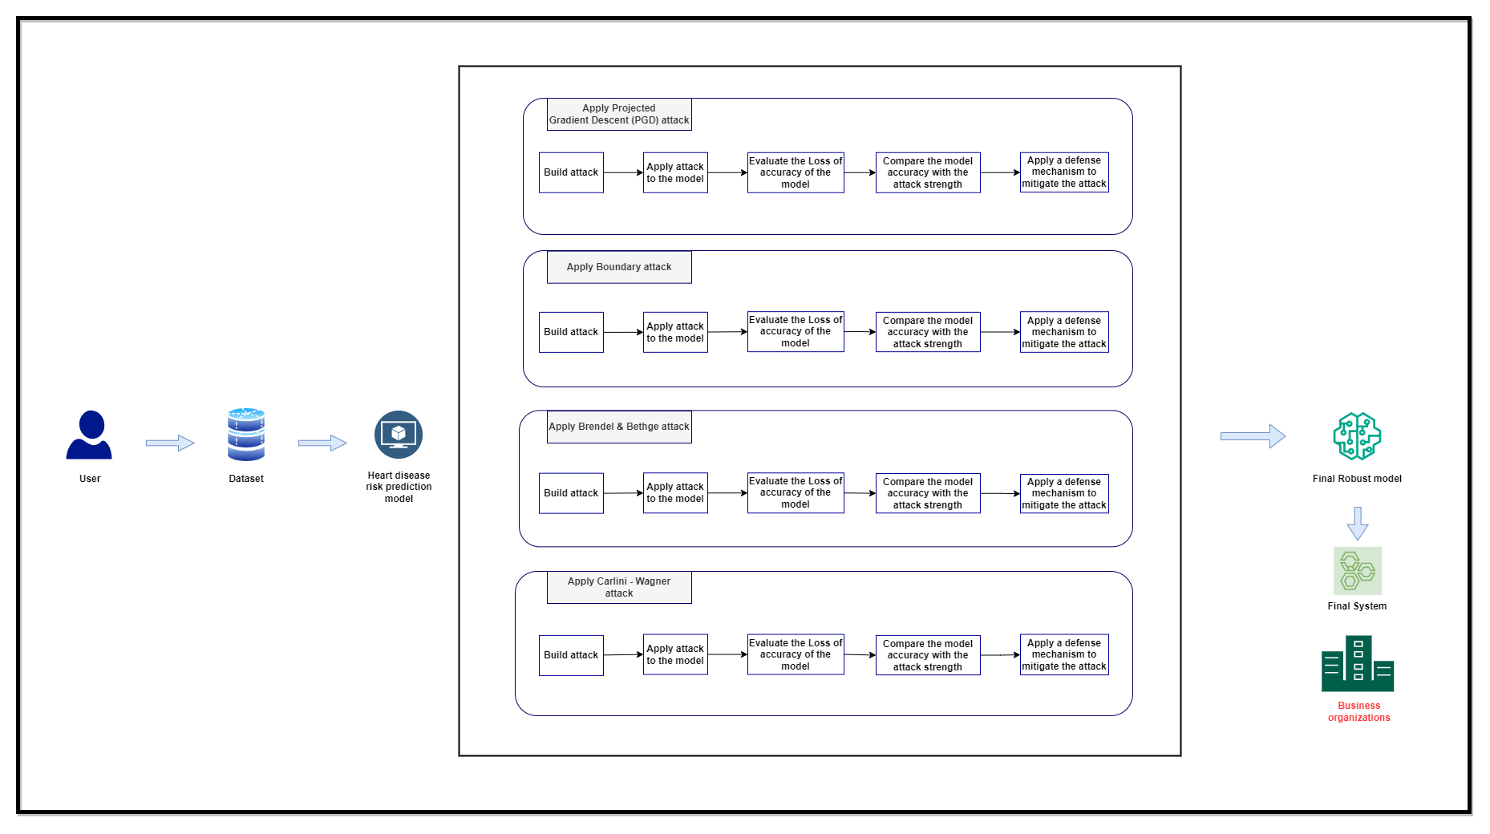
System Diagram

Slide 10
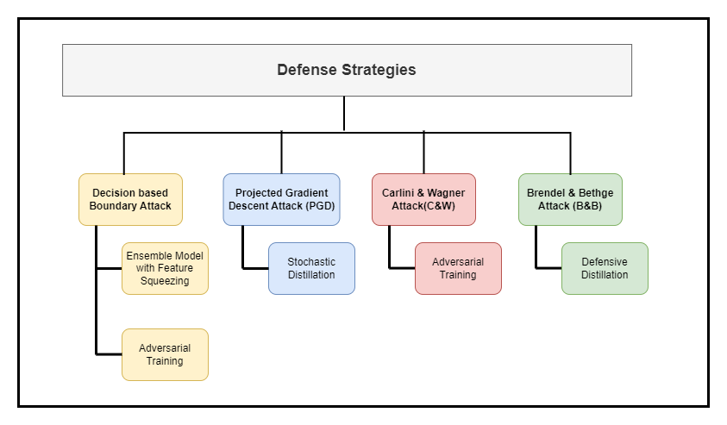
Defensive Strategies

Slide 11
References
[1] A. Qayyum, J. Qadir, M. Bilal and A. Al-Fuqaha, "Secure and Robust Machine Learning for Healthcare: A Survey," in IEEE Reviews in Biomedical Engineering, vol. 14, pp. 156-180, 2021, doi: 10.1109/RBME.2020.3013489.
[2] M. Xue, C. Yuan, H. Wu, Y. Zhang and W. Liu, "Machine Learning Security: Threats, Countermeasures, and Evaluations," in IEEE Access, vol. 8, pp. 74720-74742, 2020, doi: 10.1109/ACCESS.2020.2987435.
[3] sedawei, O. (2023) CVD_CLEANED, Kaggle. Available at: https://www.kaggle.com/datasets/omersedawei/cvd-cleaned/data (Accessed: 02 January 2024).

Slide 12

IT21023514|Karandawala d.n
Bachelor of Science (Hons) in Information Technology
Specializing in Cyber Security
IT21023514 | Karandawala D.N | R24-102

Slide 13
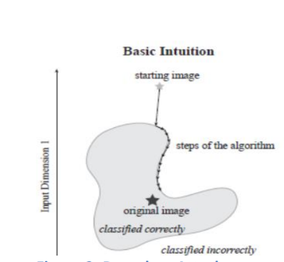
INTRODUCTION AND BACKGROUND
Boundary attack(BA).
Boundary Attack(BA) is a black box adversarial attack.
Decision Base Attack- Perturbations are made to the target variable.
BA algorithm is initialized at an adversarial example and gradually moves closer to the accurately classified example.
IT21023514 | Karandawala D.N | R24-102

Slide 14

Research Question
Is neural network model trained on tabular data sensitive to Boundary Attacks?
What mechanisms can be applied to make the model robust against this attack?
IT21023514 | Karandawala D.N | R24-102

Slide 15
RESEARCH GAP
Most existing researches apply Boundary attacks on image datasets.
No research has been applied and tested adversarial attacks on CNN models trained on tabular datasets.
IT21023514 | Karandawala D.N | R24-102

Slide 16
RESEARCH GAP
Requirements | Research A[4] | Research B[5] | Research C[6] | Research D[7] | Disease Prediction
Black-Box Attack |  |  |  |  | 
Decision Based Attack |  |  |  |  | 
Apply Boundary Attack |  |  |  |  | 
Model trained on tabular data |  |  |  |  | 
Evaluate defense mechanisms |  |  |  |  | 
Specific Application Oriented |  |  |  |  | 
IT21023514 | Karandawala D.N | R24-102

Slide 17
PROJECT OBJECTIVES
Main Objective
To Assess how the Boundary attack affects the proposed model and identify how to make the model stronger in order to protect models from DBA in a specific domain i.e. CVD Prediction models for Healthcare organizations.
Sub Objectives
  Build a Heart disease prediction neural network model with high accuracy and perform the boundary attack.
  Evaluate the effect of the attack on the built model.
  Attempt to make the model robust with defenses to protect the model from the proposed attack.
  Build a system that evaluates if the proposed attack affects the accuracies of a model given by the user and suggests ways to make it robust if it does.
IT21023514 | Karandawala D.N | R24-102

Slide 18

RESEARCH METHODOLOGY
System Diagram
Technologies to be used
Requirements (Functional /Non-functional)
Work Breakdown Structure / Gantt Chart
IT21023514 | Karandawala D.N | R24-102

Slide 19
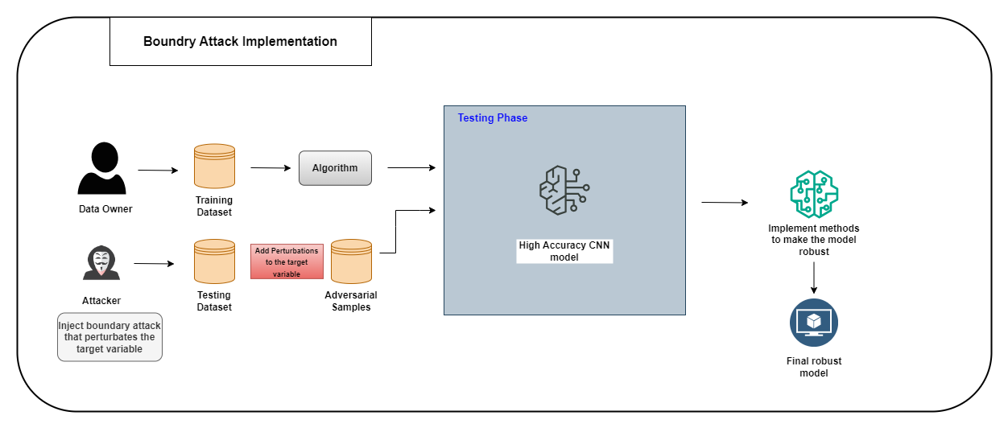
System Diagram
IT21023514 | Karandawala D.N | R24-102

Slide 20
IT21023514 | Karandawala D.N | R24-102

Slide 21
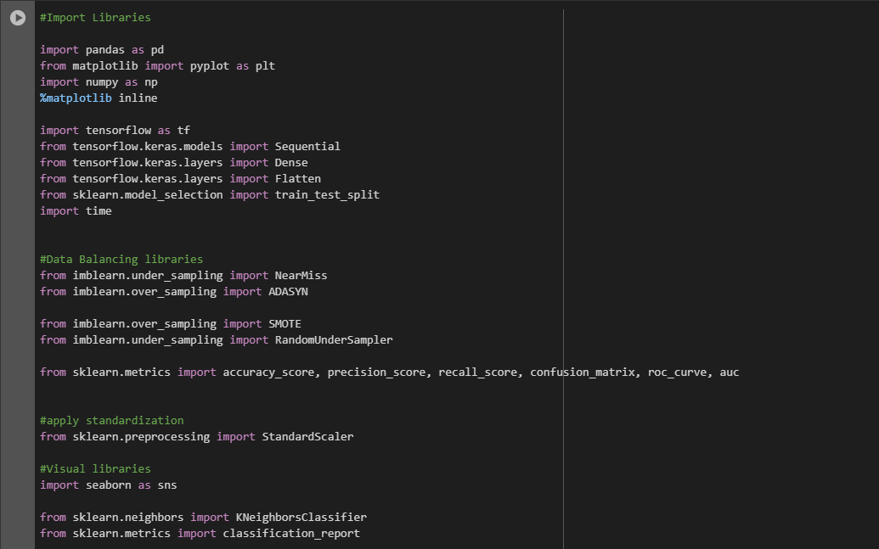
Completion of the Project
Libraries Imported
IT21023514 | Karandawala D.N | R24-102

Slide 22
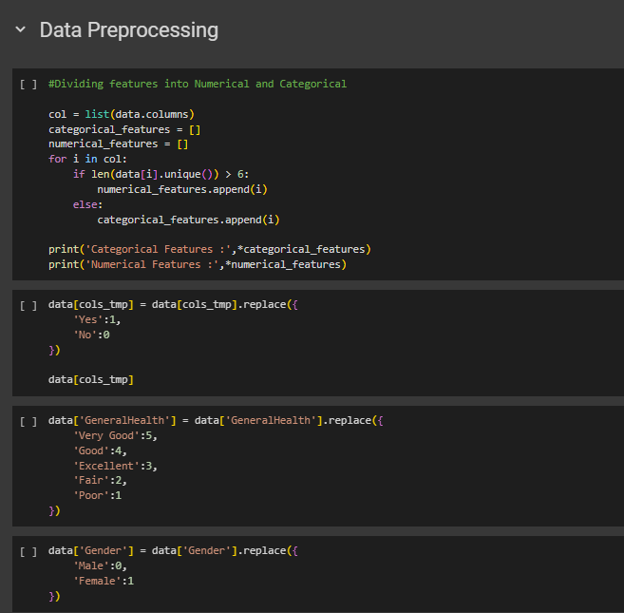
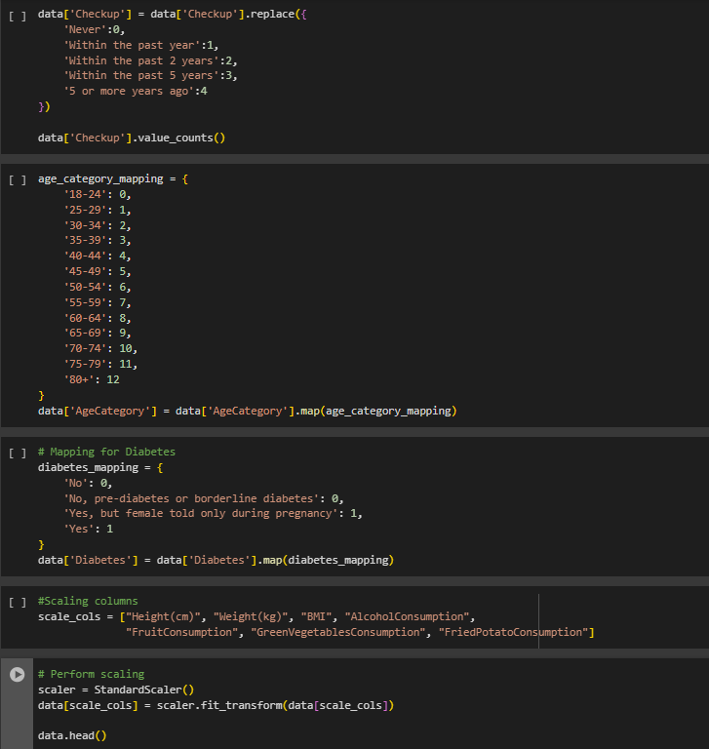
Completion of the Project
1. Data Preprocessing
IT21023514 | Karandawala D.N | R24-102
Notes:
Data collection → Include a Screenshot of the dataset with number of features and records (Original)
Data Preprocessing → SS of the code snippet and the Letter of the doctors confirmation on the features

Slide 23
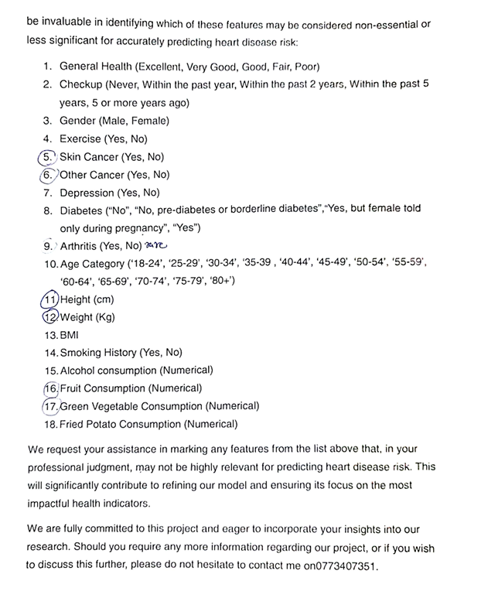
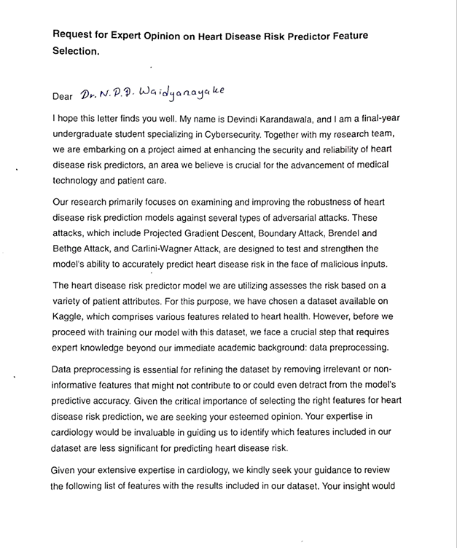
Completion of the Project
1. Data Preprocessing
IT21023514 | Karandawala D.N | R24-102
Notes:
Data collection → Include a Screenshot of the dataset with number of features and records (Original)
Data Preprocessing → SS of the code snippet and the Letter of the doctors confirmation on the features

Slide 24
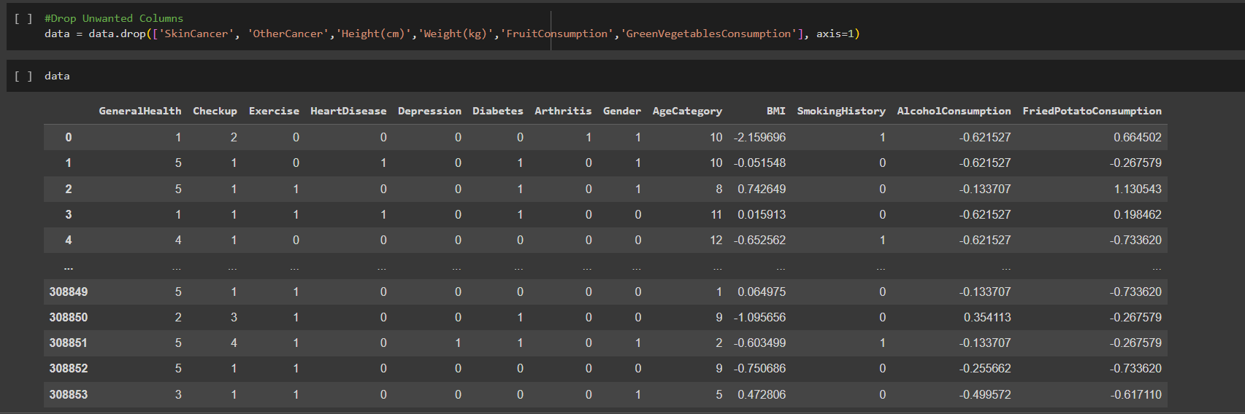
Completion of the Project
1. Data Preprocessing
IT21023514 | Karandawala D.N | R24-102
Notes:
Data collection → Include a Screenshot of the dataset with number of features and records (Original)
Data Preprocessing → SS of the code snippet and the Letter of the doctors confirmation on the features

Slide 25
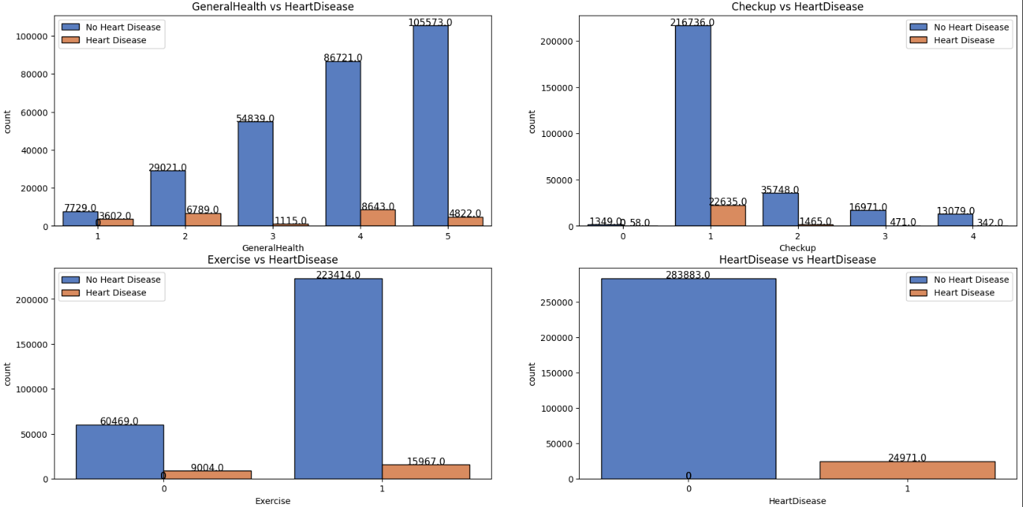
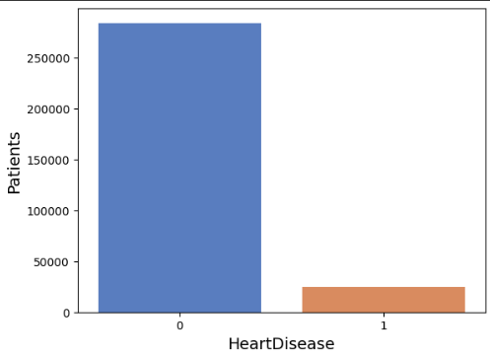
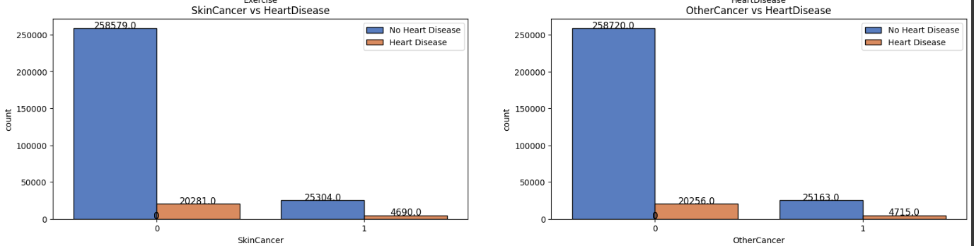
Completion of the Project
2. EDA
IT21023514 | Karandawala D.N | R24-102

Slide 26
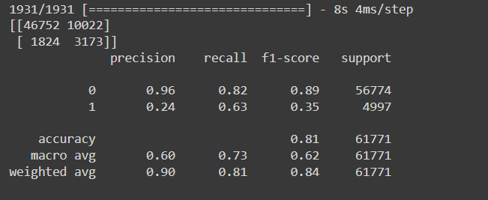
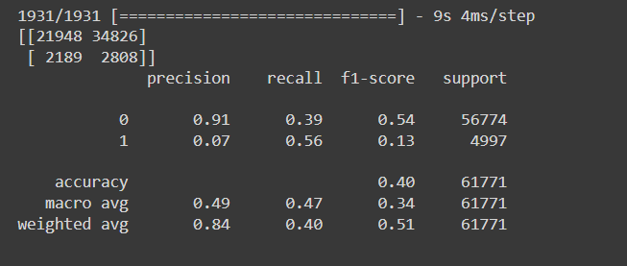
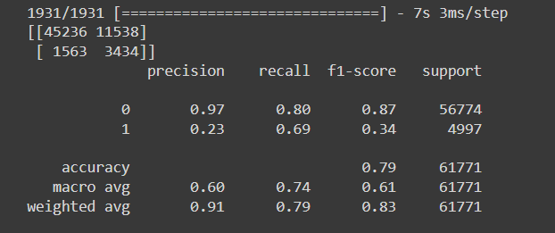
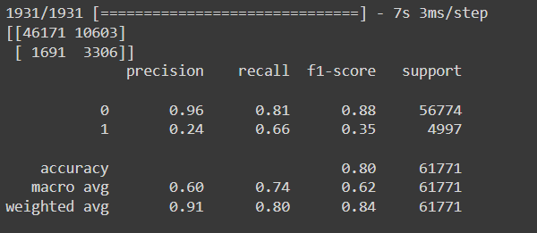
Completion of the Project
3. Data Balancing
Random Undersampling
NearMiss
ADASYN
SMOTE
IT21023514 | Karandawala D.N | R24-102

Slide 27
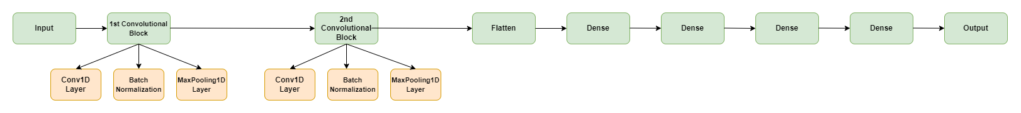
Completion of the Project
4. Model Building
  Since the CVD Prediction data was imbalanced, we used sampling methods to balance the data (SMOTE and Random Under sampling were chosen).
  Built a 1D Convolutional Neural Network Model with high accuracy to predict Heart Disease of Patients.
IT21023514 | Karandawala D.N | R24-102

Slide 28
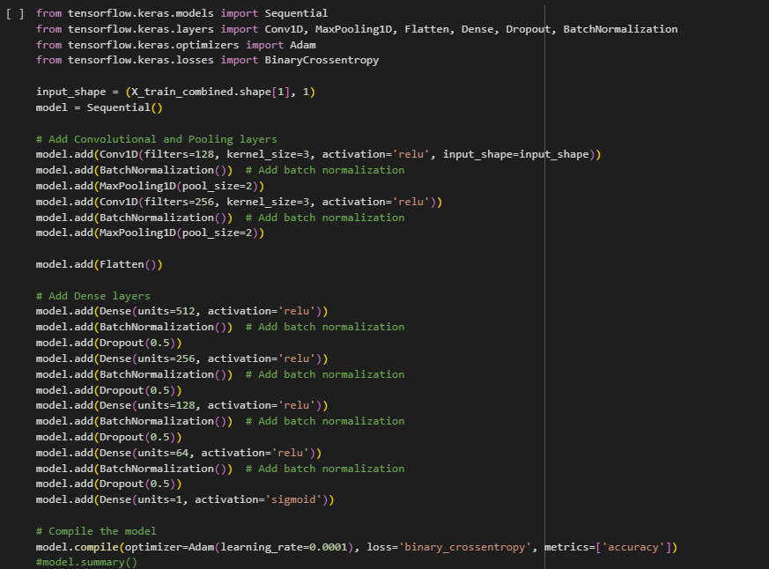
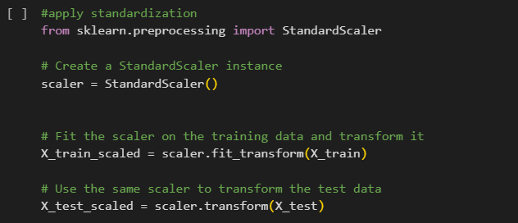
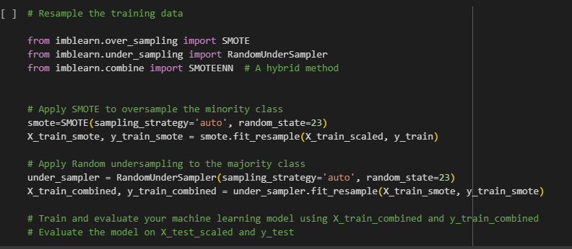
Original Model -1D CNN
IT21023514 | Karandawala D.N | R24-102

Slide 29
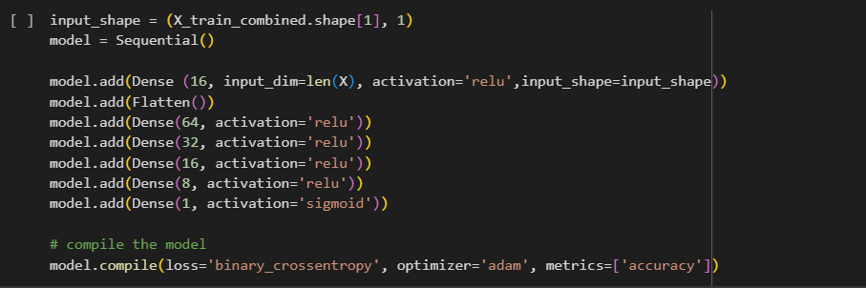

Secondary Model - DNN
IT21023514 | Karandawala D.N | R24-102

Slide 30
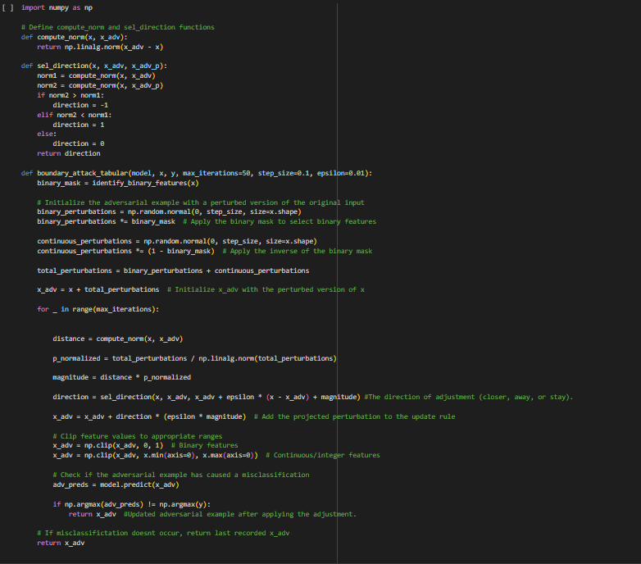
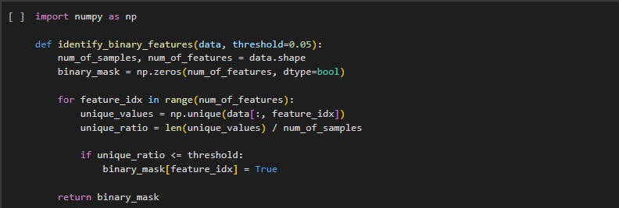
Completion of the Project
5. Define and Apply Boundary Attack
IT21023514 | Karandawala D.N | R24-102

Slide 31
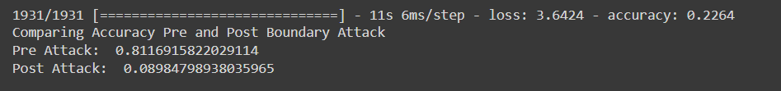

6. Evaluate Accuracy Pre and Post Attack
1D CNN Model
DNN Model
IT21023514 | Karandawala D.N | R24-102

Slide 32

Defense Strategies
With relevant to Boundary attack , 2 defense strategies were identified and tested to make the model robust.
      Ensemble Model with Feature Squeezing
      Adversarial Training
IT21023514 | Karandawala D.N | R24-102

Slide 33
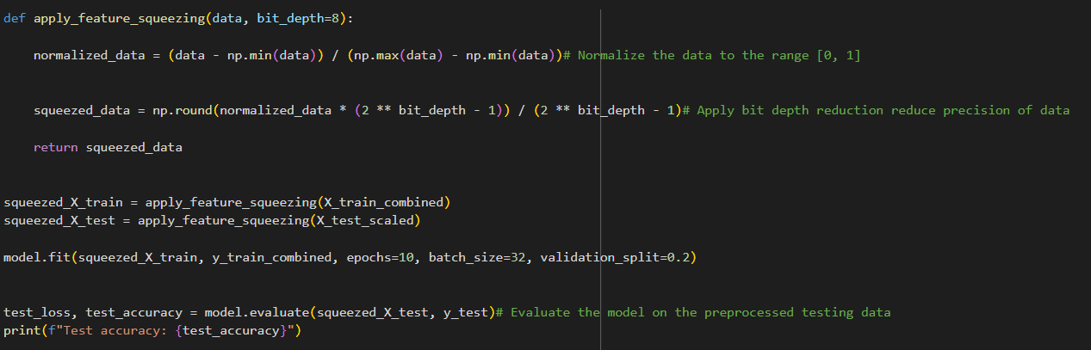
Feature Squeezing
Reduces the precision by rounding the input data to a lower bit depth and limiting the range of possible values and ensure that data points are on same scale.
Reducing the precision of the feature values aims to make the model less sensitive to small, adversarial changes in the input data.

Slide 34
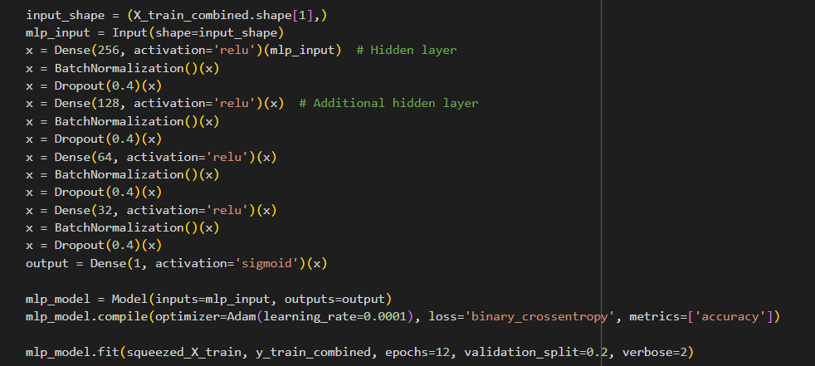
Ensemble Model
Combines the predictions of multiple models. Mitigates individual model vulnerabilities and reduce susceptibility to adversarial examples.
Step 01: Build and Train Multiple Models
In addition to the original model;
Model 1: Multilayer Perceptron Model

Slide 35
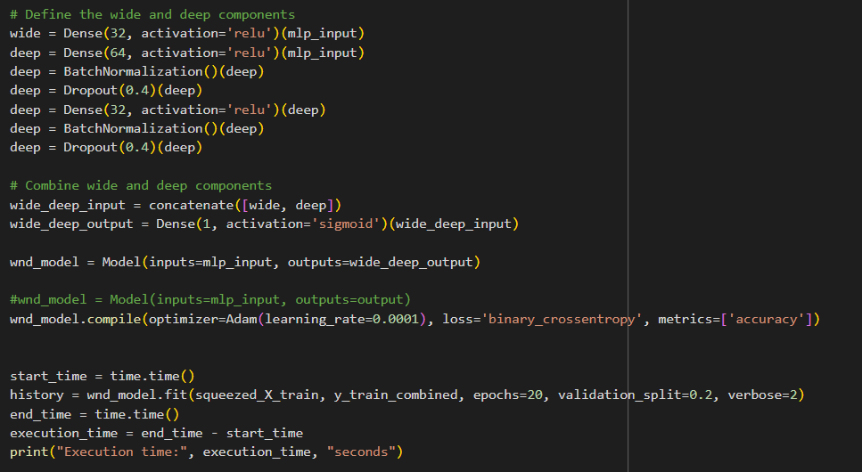
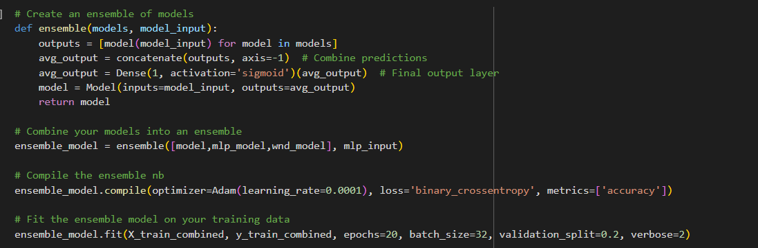
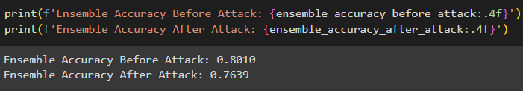
Ensemble Model
Model 2: Wide and Deep Model Step 02:Build and Train Ensemble Model
Step 03: Evaluate Accuracies
Notes:
Wide component--> Memorize specific details from examples rather than learning general patterns.
Deep component--> The ability of a deep learning model to learn and properly predict the pattern of unseen data.

Slide 36

Adversarial Training
A technique used to enhance the robustness of machine learning models by training them with intentionally perturbed data to resist deceptive inputs.
Adversarial training contains both clean and adversarial samples combined together.
    Clean samples – Original input samples
    Adversarial samples – They are the Adversarial samples generated from the Boundary attack
This is done to make the model resistant to adversarial attacks by training it on these perturbed examples so that when an input data sample is given the model can identify adversarial samples.

Slide 37
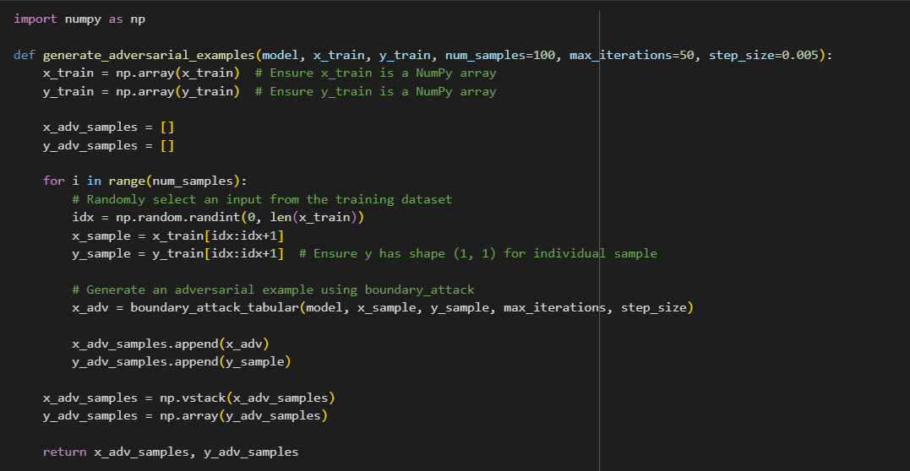
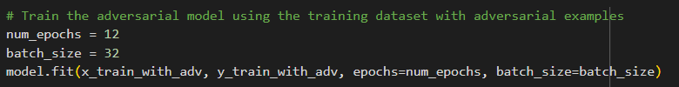
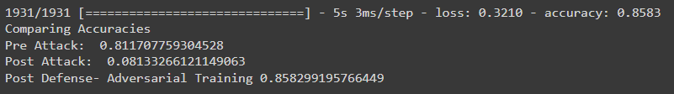
Adversarial Training
Step 01: Generate Adversarial Samples Step 02: Train the Model with Adversarial Samples
Step 03: Evaluate Accuracy

Slide 38

8. Future Checklist
System Development
Test other datasets and models using the developed system.
Product Deployment
IT21023514 | Karandawala D.N | R24-102

Slide 39
Completion of the Project
9. Challenges Faced
Problem | Solution
Applying and testing Defense mechanisms | Went through several literatures done for defensive strategies and implemented the defense for tabular boundary attack.
IT21023514 | Karandawala D.N | R24-102

Slide 40
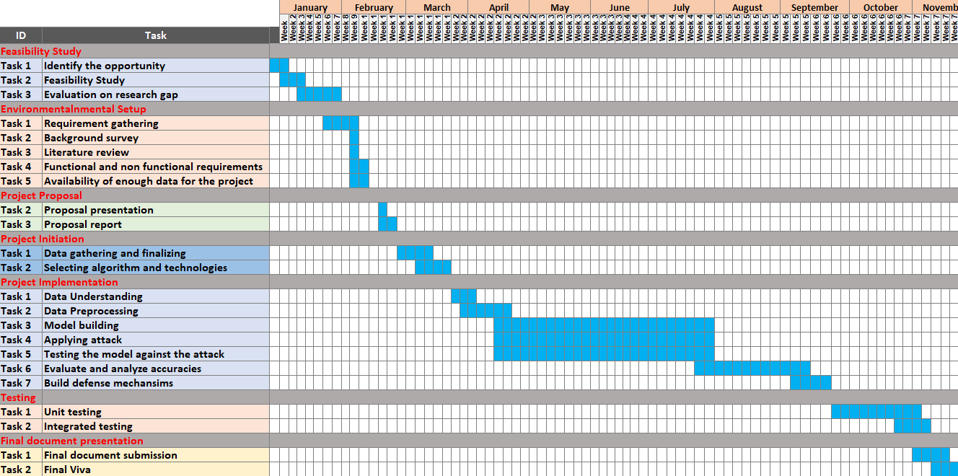
GANTT CHART
IT21023514 | Karandawala D.N | R24-102

Slide 41
REFERENCES
[1] W. Brendel, J. Rauber, and M. Bethge, “Decision-Based Adversarial Attacks: Reliable
Attacks Against Black-Box Machine Learning Models.” arXiv, Feb. 16, 2018. [Online]. Available: http://arxiv.org/abs/1712.04248
[2] Z. Xiao, P. Yang, Y. Jiang, K.-W. Chang, and C.-J. Hsieh, “BOSH: An Efficient Meta
Algorithm for Decision-based Attacks.” arXiv, Oct. 14, 2019.
[Online]. Available: http://arxiv.org/abs/1909.04288
[3] L. Ju, R. Cui, J. Sun and Z. Li, "A Robust Approach to Adversarial Attack on Tabular Data for Classification Algorithm Testing," 2022 8th International Conference on Big Data and Information Analytics (BigDIA), Guiyang, China, 2022, pp. 371-376, doi: 10.1109/BigDIA56350.2022.9874200.
[4] Jiang, W. et al. (2020) “Poisoning and evasion attacks against deep learning algorithms in
Autonomous Vehicles,” IEEE Transactions on Vehicular Technology, 69(4), pp. 4439–
4449. Available at: https://doi.org/10.1109/tvt.2020.2977378.‌
‌
‌
IT21023514 | Karandawala D.N | R24-102

Slide 42

IT21068164 | Weerakoon R. A. D. D. C
B.Sc.(Hons) in Information Technology
Specializing in Cyber Security
IT21068164 | Weerakoon R. A. D. D. C | R24-102

Slide 43

Introduction and Background
Adversarial Project Gradient Descent Attack on Machine Learning
  It is a White box adversarial attack.
Co-concept Gradient descent
  Popular optimization technique in ML.
  Minimizes loss function by adjusting model parameters.
PGD attacks are versatile and can be applied to different domains.
IT21068164 | Weerakoon R. A. D. D. C | R24-102

Slide 44
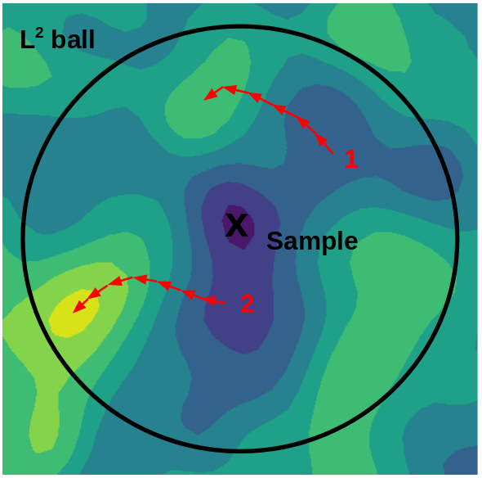
Introduction and Background
How the attack works,
Starting Point: Select a data sample correctly identified by the model.
Initial Perturbation: Make a small, random perturbations within the allowed Lp ball range.
Gradient Calculation: Find the gradient of the loss function to see which way will increase the model's error.
Adversarial Update: Change the data towards that direction to boost the error.
Projection: Keep each updated data within the Lp ball's limits.
Iteration: Do these steps over again to fine-tune the adversarial example, balancing its potency and stealth.
The image illustrates how a data point, called "Sample," is altered within a circle (the L2 ball) to trick a model, with arrows indicating potential changes that stay within the circle's limits.
IT21068164 | Weerakoon R. A. D. D. C | R24-102

Slide 45

Research Question
Is the Disease risk prediction model sensitive to project gradient descent attack?
How can we make our model robust against this attack?
IT21068164 | Weerakoon R. A. D. D. C | R24-102
Notes:
My research centered around two main questions.
Is the heart disease risk prediction model vulnerable to PGD attack?
How can we improve its robustness against PGD attack?

Slide 46
Project objective
Main Objective
To explore and understand the Projected Gradient Descent (PGD) attack by seeing how it impacts the model we use. Check for any changes in accuracy and produce ways to make our disease risk prediction model stronger against the attack.
Sub Objective
Build a neural network model for disease prediction with high accuracies and test it against the gradient descent attack.
Train the model along with adversarial examples to identify methods to make the model robust as much as possible.
Develop a system to evaluate attacks for a model given by the user and suggest methods to make the model robust.
IT21068164 | Weerakoon R. A. D. D. C | R24-102
Notes:
Explore the PGD attack's impact on our model and strengthen its robustness.

Slide 47
Research Gap
Existing research on project gradient descent attacks has predominantly focused on image datasets, with a lack of exploration into their application on tabular data.
No research has researched how this attack would result in a disease risk prediction dataset and how to make them robust.
IT21068164 | Weerakoon R. A. D. D. C | R24-102

Slide 48

Research Gap
 | Research A[1] | Research B[2] | Research C[3] | Research D[4] | Research E[5] | Disease Prediction
Tested on tabular data | X | X |  | X | X
Tested on PGD attack |  |  | X |  | X
Define PGD attack defense mechanisms | X |  | X |  | X
Specific application oriented | X |  | X | X
IT21068164 | Weerakoon R. A. D. D. C | R24-102

Slide 49

Methodology
System Architecture
Tools and Technologies
Requirements
Work Breakdown Structure
Gantt Chart
IT21068164 | Weerakoon R. A. D. D. C | R24-102

Slide 50
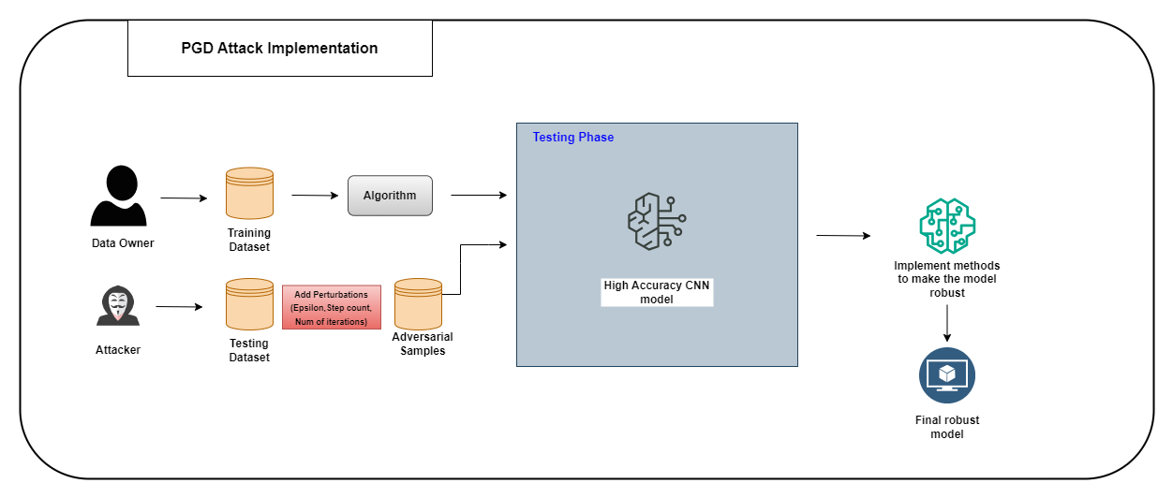
System Architecture
IT21068164 | Weerakoon R. A. D. D. C | R24-102
Notes:
Epsilon – linked with lp ball. Set a limit on how much we can change the input data.
Step count – determines size of changes at each iteration.
No of iter – How many times the pertubation process.

Slide 51
IT21068164 | Weerakoon R. A. D. D. C | R24-102

Slide 52
Completion of the Project
Data Preprocessing
IT21068164 | Weerakoon R. A. D. D. C | R24-102
Notes:
Data collection → Include a Screenshot of the dataset with number of features and records (Original)
Data Preprocessing → SS of the code snippet and the Letter of the doctors confirmation on the features

Slide 53
Completion of the Project
IT21068164 | Weerakoon R. A. D. D. C | R24-102
Notes:
Libraries Imported → SS of the code snippet
Data Preprocessing → SS of the code snippet and the Letter of the doctors confirmation on the features

Slide 54
Completion of the Project
3. Data Balancing
Random Undersampling
NearMiss
ADASYN
SMOTE
IT21068164 | Weerakoon R. A. D. D. C | R24-102

Slide 55
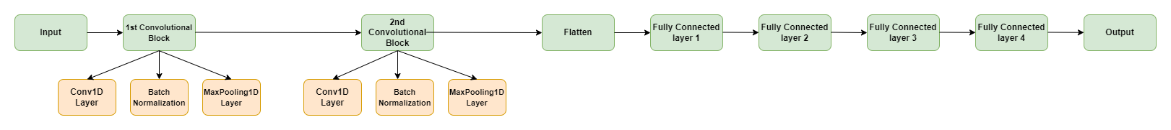
Completion of the Project
2. Model Building
  Used data sampling methods to deal with the imbalance of the dataset (SMOTE and Random Under-sampling were chosen).
  Built a 1D Convolutional Neural Network Model with high accuracy to predict Heart Disease of Patients.
IT21068164 | Weerakoon R. A. D. D. C | R24-102
Notes:
Data Preprocessing → SS of the code snippet and the Letter of the doctors confirmation on the features

Slide 56
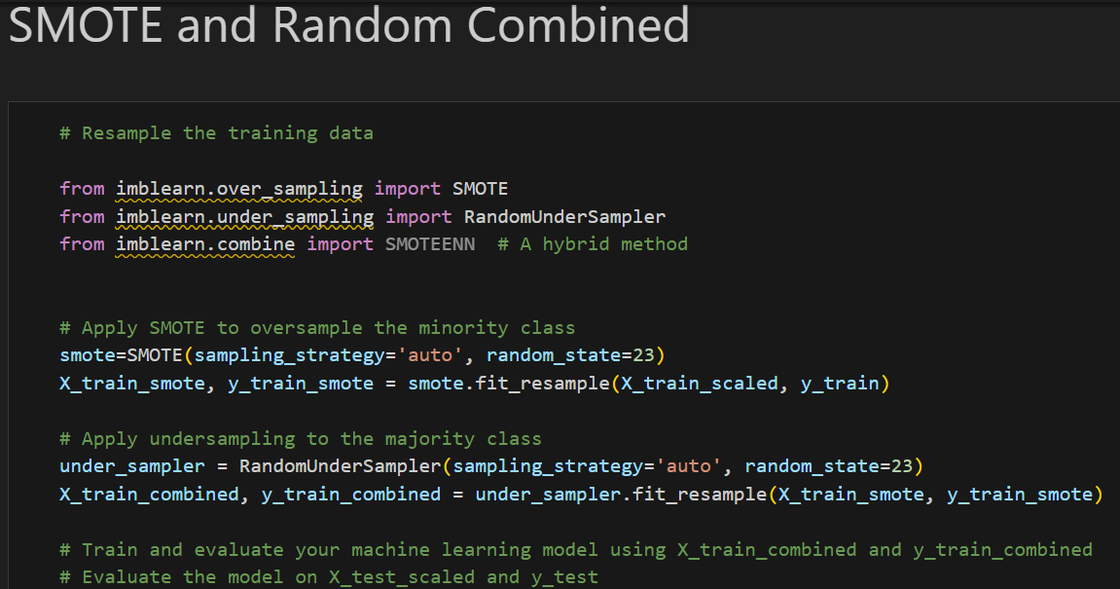
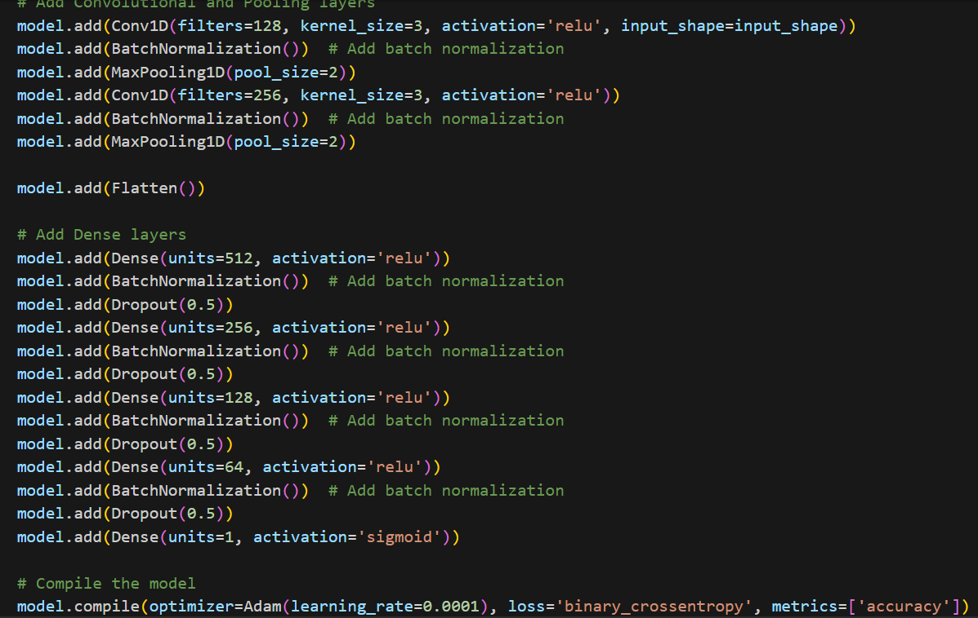
Completion of the Project
2. Model Building – CNN model
- Code Samples
IT21068164 | Weerakoon R. A. D. D. C | R24-102
Notes:
EDA

Slide 57
Secondary Model - DNN
IT21068164 | Weerakoon R. A. D. D. C | R24-102

Slide 58
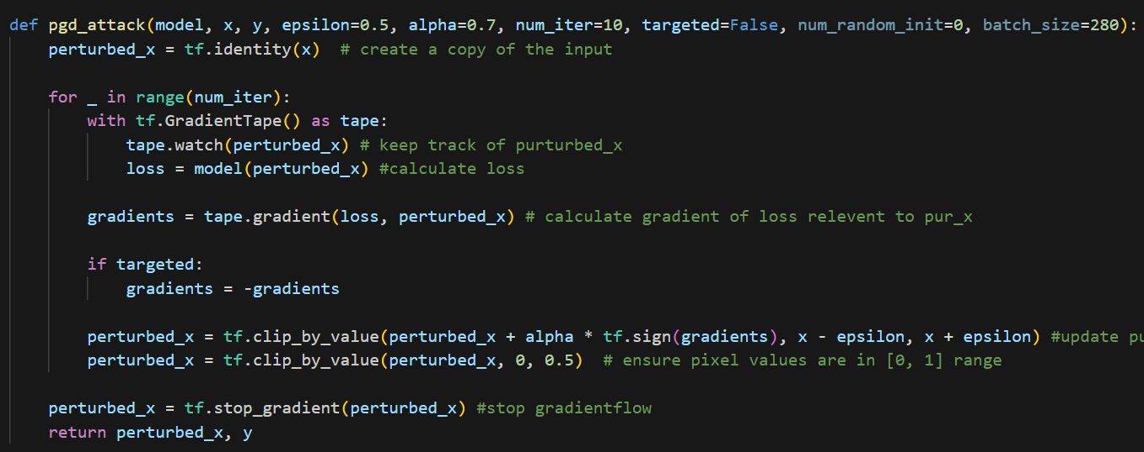
Completion of the Project
3. Define and Apply PGD Attack
IT21068164 | Weerakoon R. A. D. D. C | R24-102
Notes:
Code snippet of model building

Slide 59
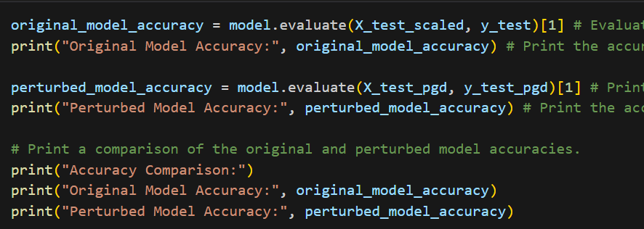
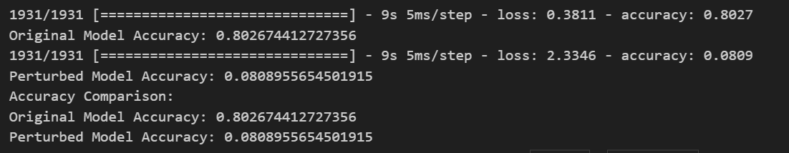
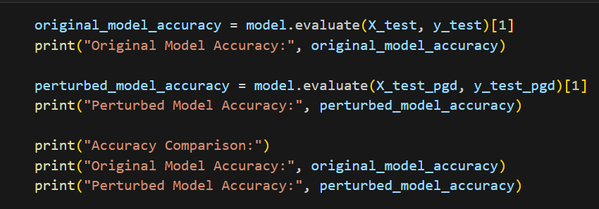
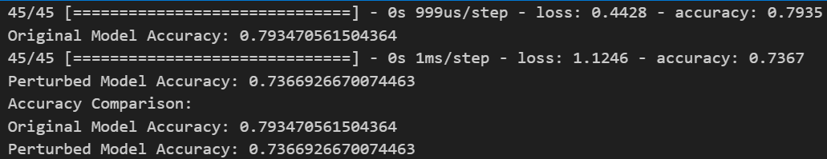
6. Evaluate Accuracy Pre and Post Attack
1D CNN Model
DNN Model
IT21068164 | Weerakoon R. A. D. D. C | R24-102
Notes:
As per the panel's request, we will also try out a DNN model in addition to our CNN model.

Slide 60
Defense Strategies
      Stochastic Distillation
Enhances Model Robustness: Introduces randomness in the distillation process to defend against adversarial attacks.
Temperature Scaling: Softens predictions by scaling logits (raw, unnormalized scores from the model), adding variability to the model's responses.
Random Shuffling: Shuffles data and labels to prevent the model from memorizing sample order and improve generalization.
Key Mechanisms:
Loss Calculation: Uses a randomly chosen temperature for each batch to calculate loss with softened logits.
Training Process:
  Epoch Loop: Iterates through multiple epochs, shuffling data each time.
  Batch Processing: For each batch, selects a random temperature and trains the model with stochastic distillation loss.
Model Evaluation: Monitors performance on validation data, ensuring robust learning and adaptation.
IT21068164 | Weerakoon R. A. D. D. C | R24-102

Slide 61
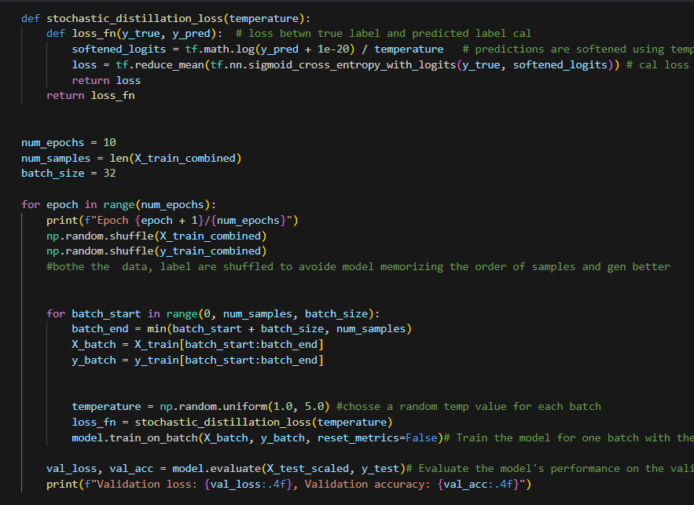
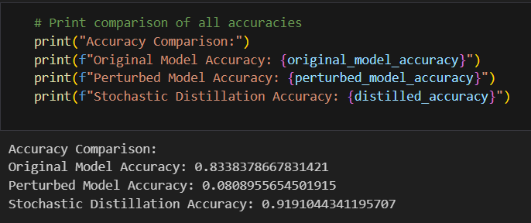
Accuracy Comparison After Defense
IT21068164 | Weerakoon R. A. D. D. C | R24-102
Notes:
It adds randomness during training to make the model more robust. Temperature scaling softens predictions, and random shuffling prevents the model from memorizing patterns. This improves generalization and helps the model resist adversarial attacks.

Slide 62
Gantt Chart

Slide 63
References
[1] Y. Jiang, G. Yin, Y. Yuan, and Q. Da, “Project Gradient Descent Adversarial Attack against Multisource Remote Sensing Image Scene Classification,” Security and Communication Networks, vol. 2021, p. e6663028, Jun. 2021, doi: https://doi.org/10.1155/2021/6663028. https://www.hindawi.com/journals/scn/2021/6663028/
[2] M. S. Ayas, S. Ayas and S. M. Djouadi, "Projected Gradient Descent Adversarial Attack and Its Defense on a Fault Diagnosis System," 2022 45th International Conference on Telecommunications and Signal Processing (TSP), Prague, Czech Republic, 2022, pp. 36-39, doi: 10.1109/TSP55681.2022.9851334. https://ieeexplore.ieee.org/document/9851334
[3] P. Rasouli and I. C. Yu, "Analyzing and Improving the Robustness of Tabular Classifiers using Counterfactual Explanations," 2021 20th IEEE International Conference on Machine Learning and Applications (ICMLA), Pasadena, CA, USA, 2021, pp. 1286-1293, doi: 10.1109/ICMLA52953.2021.00209. https://ieeexplore.ieee.org/document/9679972
[4] S. Gowal, J. Uesato, C. Qin, P.-S. Huang, T. Mann, and P. Kohli, “An Alternative Surrogate Loss for PGD-based Adversarial Testing,” 2019. Accessed: Feb. 16, 2024. [Online]. Available: https://arxiv.org/pdf/1910.09338.pdf
‌
[5] M. Xue, C. Yuan, H. Wu, Y. Zhang and W. Liu, "Machine Learning Security: Threats, Countermeasures, and Evaluations," in IEEE Access, vol. 8, pp. 74720-74742, 2020, doi: 10.1109/ACCESS.2020.2987435. https://ieeexplore.ieee.org/document/9064510
IT21068164 | Weerakoon R. A. D. D. C | R24-102

Slide 64

IT20172282 |YASUTHTHARA B.G.V
Bachelor of Science (Hons) in Information Technology
Specializing in Cyber Security
IT20172282 | Yasuththara B.G.V | R24-102

Slide 65

Introduction and Background
Carlini - Wagner (C&W) attack.
Carlini – wagner attack is a white-box adversarial attack.
Crafts imperceptible perturbations to fool machine learning models, specifically neural networks.
IT20172282 | Yasuththara B.G.V | R24-102

Slide 66

Introduction and Background
How does the attack work?
It is an optimization-based attack that works by solving an objective function.
The function optimizes perturbation magnitude while maximizing model misclassification confidence.
Uses Adam gradient descent optimization to find minimal perturbations.
Three distance metrics used: L0, L1, and L2 to quantify manipulation.
L0- Count perturbation pixel
L1- Calculates average perturbation for pixel
L2- Calculate the standard deviation
IT20172282 | Yasuththara B.G.V | R24-102

Slide 67

Research Question
How to attack a disease prediction Model with Tabular data using Carlini Attack?
How to make the Model robust against Carlini Attack?
IT20172282 | Yasuththara B.G.V | R24-102

Slide 68
Research Gap
Recent Carlini attack research primarily targets image classification, neglecting tabular data.
No prior efforts have been directed towards making disease prediction models resilient to Carlini attacks.
Implementation of defense mechanisms against Carlini attacks in disease prediction remains unexplored.
IT20172282 | Yasuththara B.G.V | R24-102

Slide 69
Research Gap
Research | Using Tabular Data to Train the Model | Making the Model Robust | Carlini Attack | Using a Neural Network Model
Research 1- [1] | ✗ | ✗ | ✓ | ✓
Research 1- [2] | ✗ | ✗ | ✓ | ✓
Research 1- [3] | ✗ | ✗ | ✗ | ✓
Research 1- [4] | ✗ | ✓ | ✗ | ✓
Research 1- [5] | ✗ | ✓ | ✗ | ✗
Disease prediction | ✓ | ✓ | ✓ | ✓
IT20172282 | Yasuththara B.G.V | R24-102

Slide 70
PROJECT OBJECTIVES
  Main Objective
  To enhance the strength of the tabular data-based disease prediction model against the Carlini & Wagner (C&W) Attack.
  Sub Objectives
  Develop a neural network model for disease prediction with high accuracy and subject it to the Carlini - Wagner (C&W) attack for evaluation.
  Identify and apply defense strategies to protect the model from the Carlini & Wagner attack.
  Build a system that can analyze a user-provided model for vulnerabilities to attacks and recommend strategies to improve its robustness.
IT20172282 | Yasuththara B.G.V | R24-102
Notes:
Change

Slide 71

Research Methodology
System Diagram
Technologies
Techniques
Requirements
Work Breakdown Structure / Gantt Chart
IT20172282 | Yasuththara B.G.V | R24-102

Slide 72

System Diagram
IT20172282 | Yasuththara B.G.V | R24-102

Slide 73
IT20172282 | Yasuththara B.G.V | R24-102

Slide 74
Completion of the Project
Libraries Imported
IT20172282 | Yasuththara B.G.V | R24-102

Slide 75
Completion of the Project
1. Data Preprocessing
IT20172282 | Yasuththara B.G.V | R24-102
Notes:
Data collection → Include a Screenshot of the dataset with number of features and records (Original)
Data Preprocessing → SS of the code snippet and the Letter of the doctors confirmation on the features

Slide 76
Completion of the Project
2. EDA
IT20172282 | Yasuththara B.G.V | R24-102
Notes:
Data collection → Include a Screenshot of the dataset with number of features and records (Original)
Data Preprocessing → SS of the code snippet and the Letter of the doctors confirmation on the features

Slide 77
Completion of the Project
3. Data Balancing
Random Undersampling
NearMiss
ADASYN
SMOTE
IT20172282 | Yasuththara B.G.V | R24-102

Slide 78
Completion of the Project
2. Model Building
  To deal with the data imbalance, we used data sampling methods to balance the dataset.
  Among the methods, SMOTE and Random Under-sampling were used.
  Built a 1D Convolutional Neural Network Model with high accuracy to predict Heart Disease of Patients.
IT20172282 | Yasuththara B.G.V | R24-102

Slide 79
Original Model -1D CNN
IT20172282 | Yasuththara B.G.V | R24-102

Slide 80
Secondary Model - DNN
IT20172282 | Yasuththara B.G.V | R24-102

Slide 81


Completion of the Project
3. Define and Apply Carlini Attack
IT20172282 | Yasuththara B.G.V | R24-102

Slide 82

Completion of the Project
4. Evaluate Accuracy Pre and Post Attack
IT20172282 | Yasuththara B.G.V | R24-102

Slide 83

6. Evaluate Accuracy Pre and Post Attack
1D CNN Model
DNN Model
IT20172282 | Yasuththara B.G.V | R24-102

Slide 84

Defense Strategy
Adversarial Training
Adversarial training involves training a model with both clean and adversarial examples.
Clean Examples: Models are trained on regular data.
Adversarial Examples: Models are also trained on adversarially perturbed data
During adversarial training, the loss function is adapted to account for both clean and adversarial examples.
.
IT20172282 | Yasuththara B.G.V | R24-102
Notes:
Clean samples in the sense that the original input data given the model and adversarial samples are generated by the carlini attack. By providing both samples, we are encouraging model to give the exact output even if there are adversarial examples.

Slide 85



Adversarial Training
Step 01: Generate Adversarial Samples Step 02: Train Model with Adversarial Samples
Step 03: Evaluate Accuracy
IT20172282 | Yasuththara B.G.V | R24-102
Notes:
The adversarial training is an effective method to overcome from the carlini and wagner attack.

Slide 86
Gantt Chart
IT20172282 | Yasuththara B.G.V | R24-102

Slide 87
REFERENCES
[1] M. Pujari, B. P. Cherukuri, A. Y. Javaid and W. Sun, "An Approach to Improve the Robustness of Machine Learning based Intrusion Detection System Models Against the Carlini-Wagner Attack," 2022 IEEE International Conference on Cyber Security and Resilience (CSR), Rhodes, Greece, 2022, pp. 62-67, doi: 10.1109/CSR54599.2022.9850306. https://www.researchgate.net/publication/362424253_An_Approach_to_Improve_the_Robustness_of_Machine_Learning_based_Intrusion_Detection_System_Models_Against_the_Carlini-Wagner_Attack
[2] N. Carlini and D. Wagner, "Towards Evaluating the Robustness of Neural Networks," in 2017 IEEE Symposium on Security and Privacy (SP), San Jose, CA, USA, 2017 pp. 39-57.doi: 10.1109/SP.2017.49
https://doi.ieeecomputersociety.org/10.1109/SP.2017.49
[3] A. Qayyum, J. Qadir, M. Bilal, and A. Al-Fuqaha, “Secure and Robust Machine Learning for Healthcare: A Survey,” IEEE Reviews in Biomedical Engineering, vol. 14, pp. 156–180, 2021, doi:
https://doi.org/10.1109/rbme.2020.3013489.https://ieeexplore.ieee.org/stamp/stamp.jsp?arnumber=9153891
[4 ] Evaluating Adversarial Learning on Different Types of Deep Learning-based Intrusion Detection Systems using min-max Optimization ] A. Qayyum, J. Qadir, M. Bilal, and A. Al-Fuqaha, “Secure and Robust Machine Learning for Healthcare: A Survey,” IEEE Reviews in Biomedical Engineering, vol. 14, pp. 156–180, 2021, doi: https://doi.org/10.1109/rbme.2020.3013489.https://ieeexplore.ieee.org/stamp/stamp.jsp?arnumber=9153891
[5] R. Khamis, “Evaluating Adversarial Learning on Different Types of Deep Learning-based Intrusion Detection Systems using min-max Optimization.” Accessed: Jan. 15, 2024. [Online]. Available: https://www.researchgate.net/publication/361541576_Adversarial_Robust_and_Explainable_Network_Intrusion_Detection_Systems_Based_on_Deep_Learning
‌
IT20172282 | Yasuththara B.G.V | R24-102

Slide 88

IT21027642|Bandara W H M T S
Bachelor of Science (Hons) in Information Technology
Specializing in Cyber Security
IT21027642| Bandara W H M T S | R24 - 102

Slide 89

Introduction and Background
Brendel & Bethge attack
This attack makes small perturbations to input data that confuse the model, especially the ones meant to recognize things in images. (Gradient-based approach)
The Brendel & Bethge attack doesn't require correctly classified example. Begins with any that is already adversarial. (Far away from the clean image.)
The where it first locates the decision boundary via a binary search, then fine-tunes the adversarial example along this boundary to minimize the distance from the original image, maintaining the misclassification.
The main goal is to find the minimal perturbation path from misclassify the image while keeping the input visually similar to the original.
IT21027642 | Bandara W H M T S | R24-102

Slide 90

Introduction and Background
How does the attack work?
Attack begins far from the original image, already in adversarial state.
It then conducts a binary search to navigate from this adversarial starting point to the decision boundary. where the model’s output changes from one class to another.
Once near the decision boundary,the attack then moves along this boundary.(Reduce the visibility of the alternations)
Next solves a constrained optimization problem to keep valid inputs and use trust radius to limit the size of perturbation. (small and controlled)
The main objective is to make the smallest possible adjustments to the adversarial example to maintain the misclassification.
IT21027642 | Bandara W H M T S | R24-102

Slide 91

Research Question
How to attack a disease prediction Model with Tabular data using Brendel & Bethge Attack?
How to make the Model robust against Brendel & Bethge Attack?
IT21027642 | Bandara W H M T S | R24-102

Slide 92
Main Objective
  To enhance the strength of the tabular data-based disease prediction model against the Brendel & Bethge attack.
Sub Objectives
Develop a neural network for disease prediction with high accuracy and subject it to the Brendel & Bethge attack for evaluation.
Identify and apply defense strategies to protect the model from the attack and enhance the robustness of the model.
Build a system that can analyze a user-provided model for these attacks and recommend strategies to improve its robustness.
IT21027642 | Bandara W H M T S | R24-102

Slide 93
Research Methodology
System Diagram
Technologies
Techniques
Requirements
Work Breakdown Structure / Gantt Chart
IT21027642 | Bandara W H M T S | R24-102

Slide 94
Research Gap
Recent Brendel & Bethge attack research primarily targets image classification, neglecting tabular data.
No prior efforts have been directed towards making disease prediction models resilient to Brendel & Bethge attacks.
Implementation of defense mechanisms against B&B attacks in disease prediction remains unexplored.
IT21027642 | Bandara W H M T S | R24-102

Slide 95
Research Gap
Research | Using Tabular Data to Train the Model | Making the Model Robust | Brendel & Bethge attack | Using a Neural Network Model
Research A- [1] | ✗ | ✗ | ✓ | ✓
Research B- [2] | ✗ | ✓ | ✗ | ✓
Research C- [3] | ✗ | ✓ | ✓ | ✓
Research D- [4] | ✗ | ✓ | ✗ | ✓
IT21027642 | Bandara W H M T S | R24-102

Slide 96

System Diagram
IT21027642 | Bandara W H M T S | R24-102

Slide 97
IT21027642 | Bandara W H M T S | R24-102

Slide 98

Completion of the Project
Libraries Imported
IT21027642 | Bandara W H M T S | R24-102

Slide 99


Completion of the Project
1. Data Preprocessing
IT21027642 | Bandara W H M T S | R24-102
Notes:
Data collection → Include a Screenshot of the dataset with number of features and records (Original)
Data Preprocessing → SS of the code snippet and the Letter of the doctors confirmation on the features

Slide 100



Completion of the Project
2. EDA
IT21027642 | Bandara W H M T S | R24-102
Notes:
Data collection → Include a Screenshot of the dataset with number of features and records (Original)
Data Preprocessing → SS of the code snippet and the Letter of the doctors confirmation on the features

Slide 101
Completion of the Project
3. Data Balancing
Random Undersampling
NearMiss
ADASYN
SMOTE
IT21027642 | Bandara W H M T S | R24-102

Slide 102
Completion of the Project
2. Model Building
  Used data sampling methods to balance the data since the dataset was imbalanced.
  SMOTE and Random Under sampling methods were chosen to for data balancing.
  Built a 1D Convolutional Neural Network Model with high accuracy to predict Heart Disease of Patients.
IT21027642 | Bandara W H M T S | R24-102

Slide 103



Completion of the Project
2. Model Building
- Code Samples
IT21027642 | Bandara W H M T S | R24-102

Slide 104
Secondary Model - DNN
IT21027642 | Bandara W H M T S | R24-102

Slide 105

Completion of the Project
3. Define and Apply Brendel & Bethge Attack
IT21027642 | Bandara W H M T S | R24-102

Slide 106

6. Evaluate Accuracy Pre and Post Attack
1D CNN Model
DNN Model
IT21027642 | Bandara W H M T S | R24-102

Slide 107
Defense Strategy
Defensive Distillation
Defensive distillation boosts neural network robustness against adversarial attacks by simplifying training data complexity.
How Defensive Distillation Works
  Trains a neural network (teacher model) to output class probabilities.
  A second network (student model) is trained on the temperature-smoothed outputs of the teacher model.
  The higher temperature during training softens the probability distribution, making the model learn more generalized features.
Application to Counter Brendel & Bethge Attack
  Brendel & Bethge attack crafts adversarial examples that are iteratively refined to be close to the decision boundaries.
  Defensive distillation helps by smoothing these boundaries, making it more challenging for the attack to find adversarial perturbations that mislead the model.
Improves generalization and reduces susceptibility to both white-box and black-box attacks.
.
IT21027642 | Bandara W H M T S | R24-102

Slide 108




Defensive Distillation
Step 03: Train the student model using soft labels
Step 01: Train the teacher model
Step 02: Generate soft labels using the teacher model
Step 04: Evaluate the student model on the original and adversarial examples
IT21027642 | Bandara W H M T S | R24-102

Slide 109

Defensive Distillation
Step 05: Comparing accuracies pre and post attack, and post-defense
IT21027642 | Bandara W H M T S | R24-102

Slide 110
Gantt Chart
IT21027642 | Bandara W H M T S | R24-102

Slide 111
References
[1] Brendel, W. (2019, July 1). Accurate, reliable and fast robustness evaluation. arXiv.org. https://arxiv.org/abs/1907.01003
[2] Athalye, A. (2018, February 1). Obfuscated Gradients Give a False Sense of Security: Circumventing Defenses to Adversarial Examples. arXiv.org. https://arxiv.org/abs/1802.00420
[3] Brendel, W. (2017, December 12). Decision-Based Adversarial Attacks: Reliable Attacks Against Black-Box Machine Learning Models. arXiv.org. https://arxiv.org/abs/1712.04248
[4] Madry, A. (2017, June 19). Towards Deep Learning Models Resistant to Adversarial Attacks. arXiv.org. https://arxiv.org/abs/1706.06083
IT21027642 | Bandara W H M T S | R24-102

Slide 112
Challenges Faced
Problem | Solution
Implementing the defense to tabular data. | Received support and guidance from the supervisors and the team.
IT21027642 | Bandara W H M T S | R24-102
Notes:
change

Slide 113






Tools, Technologies and Algorithms
Tools And Technologies
  Development- Python
  Building Model- Conda Notebook, Google Colab
  Version Controlling- Github
Algorithm
  Feed-Forward Algorithm
  CNN
Libraries
  Scikit-learn
  Tensor flow, Keras
  Art
  Matplotlib, Numpy, Pandas
  Streamlit

Slide 114

Functional Requirements
Accurately detecting whether the disease prediction Model is being attacked.
Mechanism to make the Robust.
Non Functional Requirements
Security
Reliability
Realtime
Availability
Usability

Slide 115


Completion of the Project
7. Best coding practices

Slide 116

Work Breakdown Structure

Slide 117

Commercialization
Our proposed system will allow healthcare organizations to test their Heart disease prediction models against the PGD, Carlini, Brendel, and Boundary attacks.
This system will allow organizations with various domains to check their models robustness against these attacks.
Quick assessment of whether the model can resist these attacks.
Provide suggestions to healthcare organizations to build safe and strong disease prediction models.
Identifying if attacks can harm users’ models before those attacks happen will help to ensure cost-effectiveness and increase the efficiency of the model.

Slide 118


Slide 119

Questions?

Slide 120
THANK YOU!

