Slide 1

Strengthening Heart Disease Prediction with CNN: Adversarial Robustness against Multiple Attacks
PROJECT ID : R24-102

Slide 2

Team Members
Supervisor – Ms. Chethana Liyanapathirana
Co-Supervisor – Mr. Deemantha Siriwardana
Student Name | Student ID
Karandawala D.N | IT21023514
Yasuththara B.G.V | IT20172282
Weerakoon R. A. D. D. C | IT21068164
Bandara W H M T S | IT21027642

Slide 3
CONTENT
INTRODUCTION AND BACKGROUND
RESEAECH PROBLEM
PROJECT OBJECTIVES
RESEARCH COMPONENTS
COMMECIALZATION
SYSTEM DIAGRAM

Slide 4




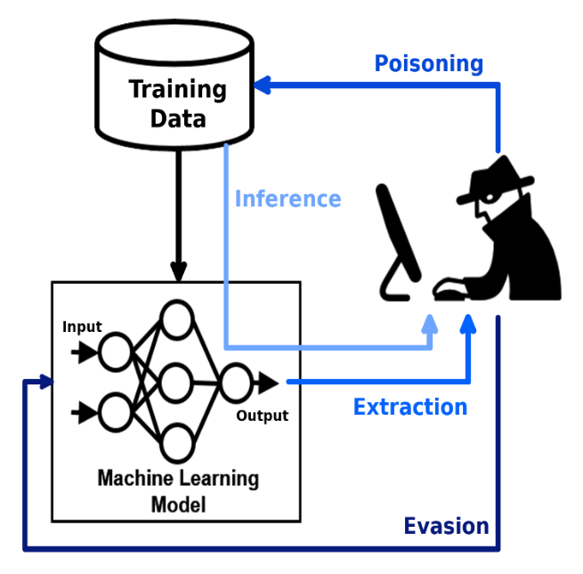
Introduction
Machine learning models are increasingly being adopted across various industries for predictive analysis, improving decision-making and operational efficiency.
Near 80% of businesses globally use machine learning and AI technologies as of 2024.
Machine learning model security is at risk due to the possibility of manipulation by harmful inputs, which can result in inaccurate predictions or classifications.
Attacks for ML models manipulate inputs or steal sensitive data, compromising model integrity and security.
This research specifically investigates the robustness of the Convolutional Neural Network (CNN) model against adversarial attacks and applies defenses against these attacks.
Resource: https://techjury.net/blog/ai-statistics/

Slide 5

Introduction
In this context, we are attempting to demonstrate the effects of four kinds of adversarial attacks namely Boundary Attack, Project Gradient Descent Attack, Carlini and Wagner attack, and Brendel-Bethge attack on a CNN model trained with Heart disease prediction dataset[3].
Heart disease prediction: To detect whether a person is suffering from heart disease by considering certain attributes.

Slide 6

Research problem
How can we make our model robust against these adversarial attacks?
What are the defense mechanisms that can we apply to make the model robust?

Slide 7

Main Objective
To assess and evaluate the effect of the above-mentioned adversarial attacks on our proposed model and attempt to increase model strength against the given attacks.

Slide 8
Sub Objectives
Build a neural network model with high accuracy for a Heart disease dataset.
Apply adversarial attacks against the model to identify changes in accuracy and evaluate the extent of the attack's impact by comparing accuracies.
Identify and test defense mechanisms to make the model robust against the said attacks.
Build a system that allows a user to input a model that will be tested against the attack and suggest methods to make the model robust if the model is affected.

Slide 9
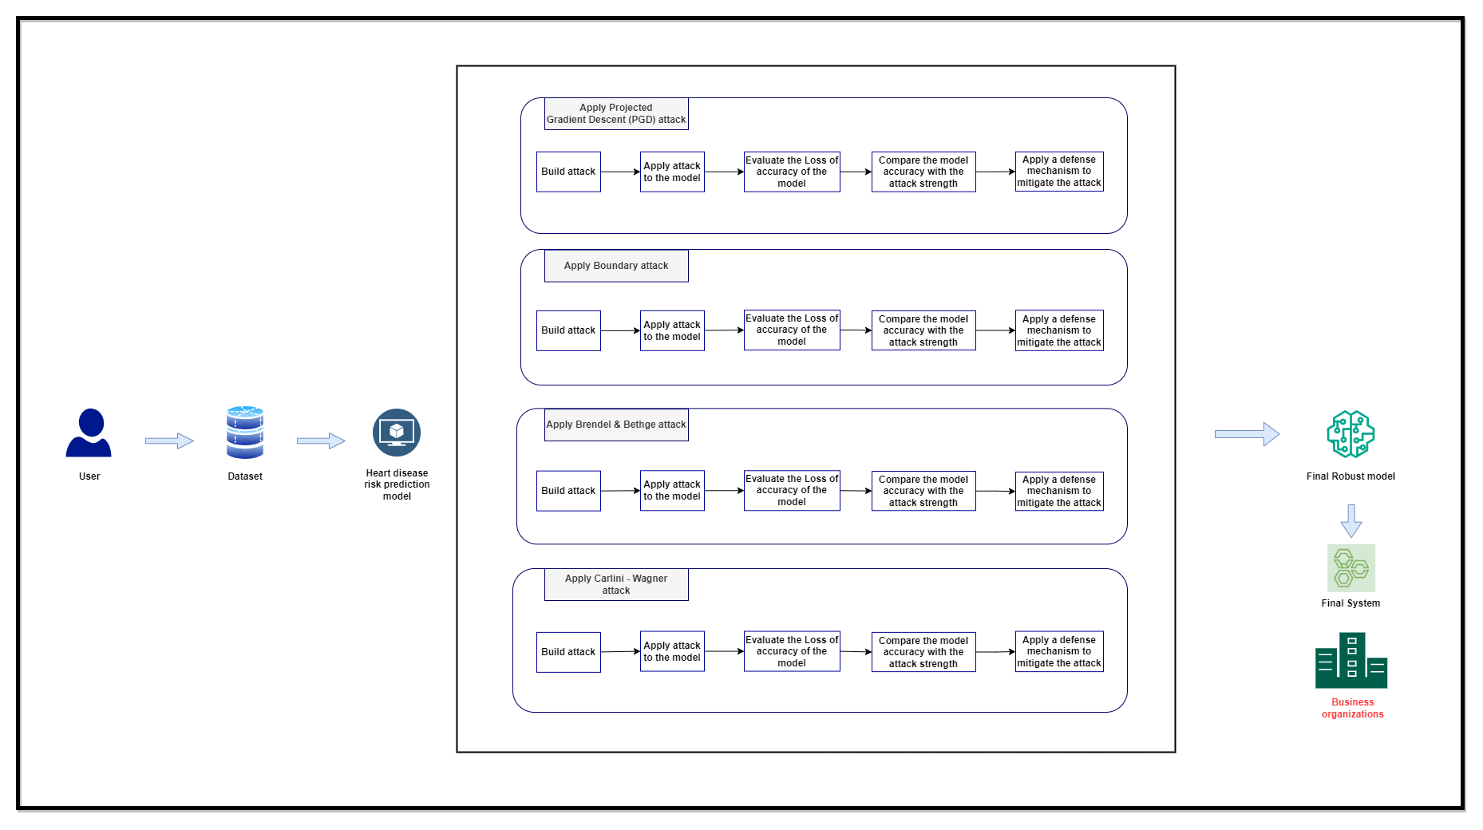
System Diagram

Slide 10
References
[1] A. Qayyum, J. Qadir, M. Bilal and A. Al-Fuqaha, "Secure and Robust Machine Learning for Healthcare: A Survey," in IEEE Reviews in Biomedical Engineering, vol. 14, pp. 156-180, 2021, doi: 10.1109/RBME.2020.3013489.
[2] M. Xue, C. Yuan, H. Wu, Y. Zhang and W. Liu, "Machine Learning Security: Threats, Countermeasures, and Evaluations," in IEEE Access, vol. 8, pp. 74720-74742, 2020, doi: 10.1109/ACCESS.2020.2987435.
[3] sedawei, O. (2023) CVD_CLEANED, Kaggle. Available at: https://www.kaggle.com/datasets/omersedawei/cvd-cleaned/data (Accessed: 02 January 2024).

Slide 11

IT21068164 | Weerakoon R. A. D. D. C
B.Sc.(Hons) in Information Technology
Specializing in Cyber Security
IT21068164 | Weerakoon R. A. D. D. C | R24-102

Slide 12
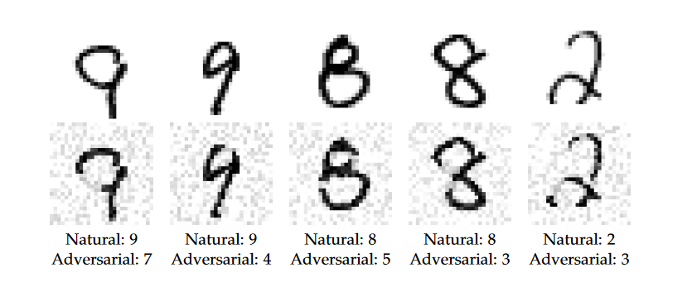
Introduction and Background
Adversarial Project gradient descent attack on Machine Learning
  It is a White box adversarial attack.
  Utilize gradient descent for iterative model deception
  Begin with a random perturbation in the LP ball.
Co-concept Gradient descent
  Popular optimization technique in ML.
  Minimizes loss function by adjusting model parameters.
PGD attacks are versatile and can be applied to different domains.
IT21068164 | Weerakoon R. A. D. D. C | R24-102

Slide 13
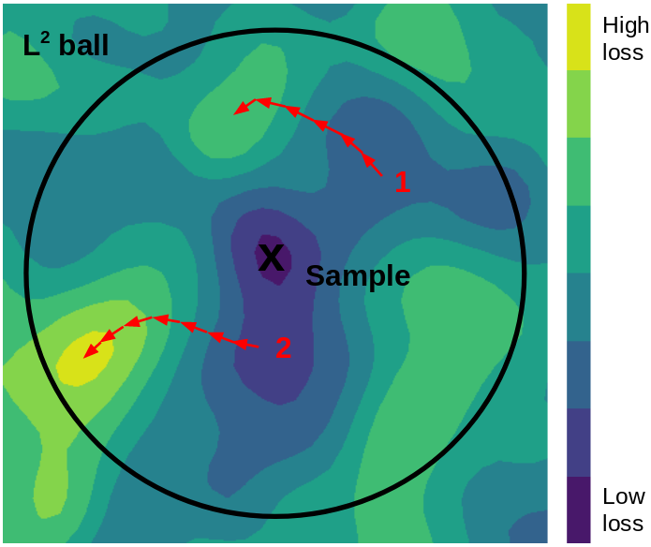
Introduction and Background
How the attack works,
Starting Point: Select a data sample correctly identified by the model.
Initial Perturbation: Make a small, random perturbations within the allowed Lp ball range.
Gradient Calculation: Find the gradient of the loss function to see which way will increase the model's error.
Adversarial Update: Change the data towards that direction to boost the error.
Projection: Keep each updated data within the Lp ball's limits.
Iteration: Do these steps over again to fine-tune the adversarial example, balancing its potency and stealth.
The image illustrates how a data point, called "Sample," is altered within a circle (the L2 ball) to trick a model, with arrows indicating potential changes that stay within the circle's limits.
IT21068164 | Weerakoon R. A. D. D. C | R24-102

Slide 14

Research Question
Are Disease risk prediction models sensitive to project gradient descent attack?
How can we make our model robust against this attack?
IT21068164 | Weerakoon R. A. D. D. C | R24-102

Slide 15
Project objective
Main Objective
Explore and understand the Projected Gradient Descent (PGD) attack by seeing how it impacts the model we use. Check for any changes in accuracy and produce ways to make our disease risk prediction model stronger against the attack.
Sub Objective
Build a neural network model for disease prediction with high accuracies and test it against the gradient descent attack.
Train the model along with adversarial examples to identify methods to make the model robust as much as possible.
Develop a system to evaluate attacks for a model given by the user and suggest methods to make the model robust.
IT21068164 | Weerakoon R. A. D. D. C | R24-102

Slide 16
Research Gap
Existing research on project gradient descent attacks has predominantly focused on image datasets, with a lack of exploration into their application on tabular data.
No research has researched how this attack would result in a disease risk prediction dataset and how to make them robust.
IT21068164 | Weerakoon R. A. D. D. C | R24-102

Slide 17
Research Gap
 | Topic
Research – A | Project Gradient Descent Adversarial Attack against Multisource Remote Sensing Image Scene Classification
Research – B | Project gradient descent adversarial attack and its defense on a fault diagnosis system.
Research – C | Analyzing and Improving the Robustness of Tabular Classifiers using Counterfactual Explanations
Research – D | An Alternative Surrogate Loss for PGD-based
Research - E | Machine learning security: Threats, countermeasures and evaluation.
IT21068164 | Weerakoon R. A. D. D. C | R24-102

Slide 18

Research Gap
 | Research A[1] | Research B[2] | Research C[3] | Research D[4] | Research E[5] | Disease Prediction
Tested on tabular data | X | X |  | X | X
Tested on PGD attack |  |  | X |  | X
Define PGD attack defense mechanisms | X |  | X |  | X
Specific application oriented | X |  | X | X
IT21068164 | Weerakoon R. A. D. D. C | R24-102

Slide 19

Methodology
System Architecture
Tools and Technologies
Requirements
Work Breakdown Structure
Gantt Chart
IT21068164 | Weerakoon R. A. D. D. C | R24-102

Slide 20
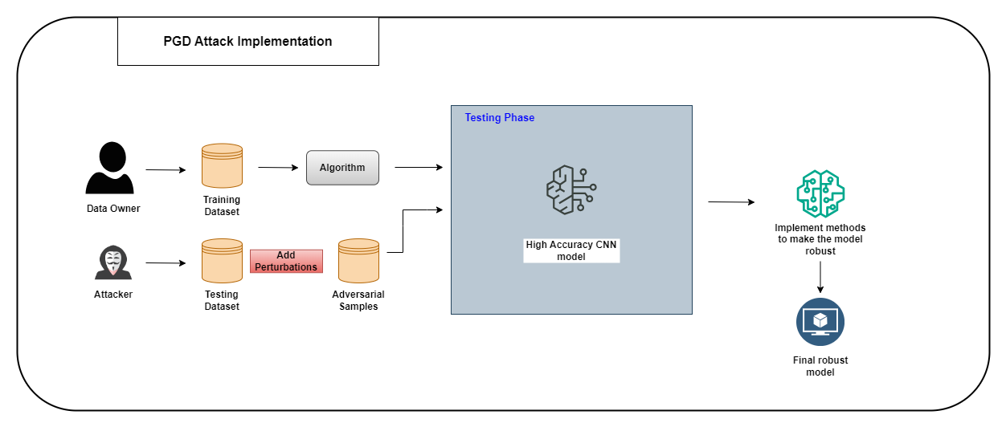
System Architecture
IT21068164 | Weerakoon R. A. D. D. C | R24-102

Slide 21






Technologies to be used
Technologies
Development - Python
Building model – Conda Notebook, Google Colab
Technology stack:
Version controlling – GitHub
Algorithm
CNN
Feed forward algorithm
Libraries
Scikit-learn ,TensorFlow
ART (Adversarial robustness toolbox)
Matplotlib, Numpy, Pandas,Keras
Stream Lit
IT21068164 | Weerakoon R. A. D. D. C | R24-102

Slide 22

Functional requirements
Determine loss of accuracies correctly after the attack is applied
Find strategies to strengthen the model's defense against the applied attack.
Non Functional requirements
Accuracy
Robustness
Security
Efficiency
IT21068164 | Weerakoon R. A. D. D. C | R24-102

Slide 23
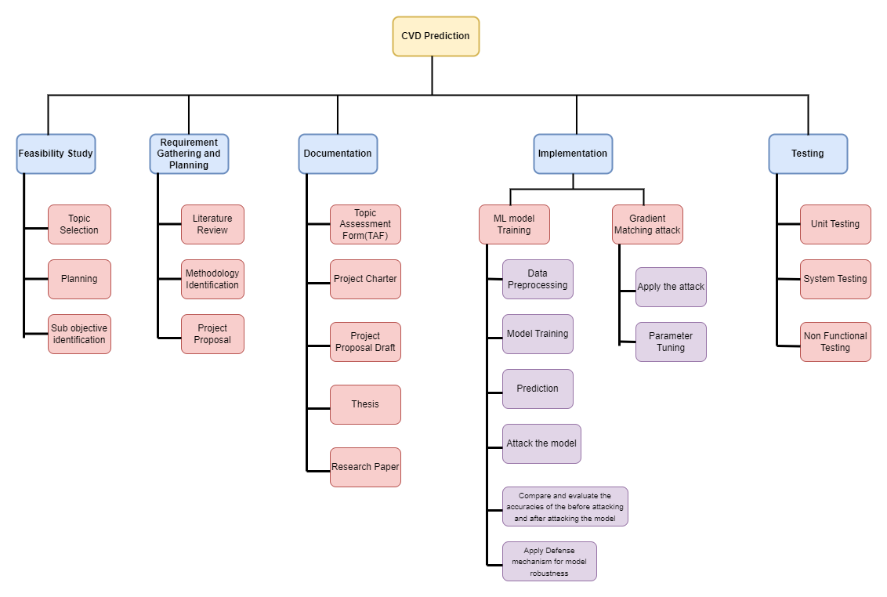
Work Breakdown Structure
IT21068164 | Weerakoon R. A. D. D. C | R24 -102

Slide 24
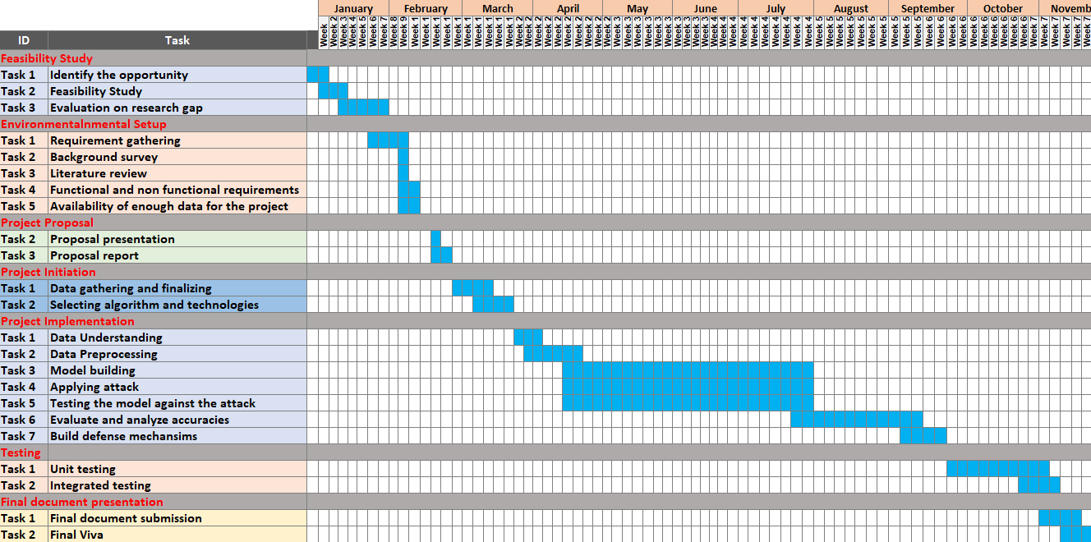
Gantt Chart
IT21068164 | Weerakoon R. A. D. D. C | R24-102

Slide 25
Completion of the project
Task | Details
Dataset | Dataset from kaggle(CVD Cleaned )
Algorithm | CNN
Literature reviews | Project Gradient Descent Adversarial Attack against Multisource Remote Sensing Image Scene Classification. Projected Gradient Descent Adversarial Attack and Its Defense on a Fault Diagnosis System. Analyzing and Improving the Robustness of Tabular Classifiers using Counterfactual Explanations. An Alternative Surrogate Loss for PGD-based Adversarial Testing.
External support | Research Rabbit Kaggle
Tools | Jupyter Notebook Google Colab
IT21068164 | Weerakoon R. A. D. D. C | R24-102

Slide 26
References
[1] Y. Jiang, G. Yin, Y. Yuan, and Q. Da, “Project Gradient Descent Adversarial Attack against Multisource Remote Sensing Image Scene Classification,” Security and Communication Networks, vol. 2021, p. e6663028, Jun. 2021, doi: https://doi.org/10.1155/2021/6663028. https://www.hindawi.com/journals/scn/2021/6663028/
[2] M. S. Ayas, S. Ayas and S. M. Djouadi, "Projected Gradient Descent Adversarial Attack and Its Defense on a Fault Diagnosis System," 2022 45th International Conference on Telecommunications and Signal Processing (TSP), Prague, Czech Republic, 2022, pp. 36-39, doi: 10.1109/TSP55681.2022.9851334. https://ieeexplore.ieee.org/document/9851334
[3] P. Rasouli and I. C. Yu, "Analyzing and Improving the Robustness of Tabular Classifiers using Counterfactual Explanations," 2021 20th IEEE International Conference on Machine Learning and Applications (ICMLA), Pasadena, CA, USA, 2021, pp. 1286-1293, doi: 10.1109/ICMLA52953.2021.00209. https://ieeexplore.ieee.org/document/9679972
[4] S. Gowal, J. Uesato, C. Qin, P.-S. Huang, T. Mann, and P. Kohli, “An Alternative Surrogate Loss for PGD-based Adversarial Testing,” 2019. Accessed: Feb. 16, 2024. [Online]. Available: https://arxiv.org/pdf/1910.09338.pdf
‌
[5] M. Xue, C. Yuan, H. Wu, Y. Zhang and W. Liu, "Machine Learning Security: Threats, Countermeasures, and Evaluations," in IEEE Access, vol. 8, pp. 74720-74742, 2020, doi: 10.1109/ACCESS.2020.2987435. https://ieeexplore.ieee.org/document/9064510
IT21068164 | Weerakoon R. A. D. D. C | R24-102

Slide 27

IT21023514|Karandawala d.n
Bachelor of Science (Hons) in Information Technology
Specializing in Cyber Security
IT21023514 | Karandawala D.N | R24-102

Slide 28
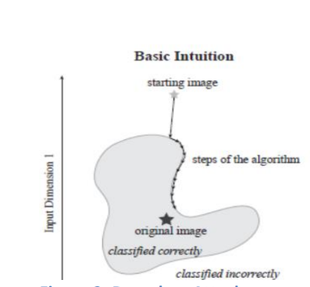
INTRODUCTION AND BACKGROUND
Boundary attack(BA).
Boundary Attack(BA) is a black box adversarial attack.
Decision Base Attack- Perturbations are made to the target variable.
BA algorithm is initialized at an adversarial example and gradually moves closer to the accurately classified example.
IT21023514 | Karandawala D.N | R24-102

Slide 29
INTRODUCTION AND BACKGROUND
How does the Boundary Attack affect Disease Risk Prediction?
The attack will perturbate the target variable in a way that cannot identified to humans. When the model is built, these perturbations will cause misclassification which will result in wrong patient disease predictions. This will lead to wrong treatments for the patients.
IT21023514 | Karandawala D.N | R24-102

Slide 30

Research Question
Are neural network models trained on tabular data sensitive to Boundary Attacks?
What mechanisms can be applied to make the model robust against this attack?
IT21023514 | Karandawala D.N | R24-102

Slide 31
RESEARCH GAP
Most existing researches apply Boundary attacks on image datasets.
No researches have been applied and tested adversarial attacks on disease risk prediction models.
IT21023514 | Karandawala D.N | R24-102

Slide 32
RESEARCH GAP
Research Study | Topic
Research A | Decision-Based Adversarial Attacks: Reliable Attacks Against Black-Box Machine Learning Models.
Research B | BOSH: An Efficient Meta Algorithm for Decision-based Attacks.
Research C | A Robust Approach to Adversarial Attack on Tabular Data for Classification Algorithm Testing.
Research D | Poisoning and evasion attacks against deep learning algorithms in Autonomous Vehicles.
IT21023514 | Karandawala D.N | R24-102

Slide 33
RESEARCH GAP
Requirements | Research A[4] | Research B[5] | Research C[6] | Research D[7] | Disease Prediction
Black-Box Attack |  |  |  |  | 
Decision Based Attack |  |  |  |  | 
Apply Boundary Attack |  |  |  |  | 
Model trained on tabular data |  |  |  |  | 
Evaluate defense mechanisms |  |  |  |  | 
Specific Application Oriented |  |  |  |  | 
IT21023514 | Karandawala D.N | R24-102

Slide 34
PROJECT OBJECTIVES
Main Objective
Access how the Boundary attack affects the proposed model and identify how to make the model stronger in order to protect models from such attacks in a specific domain i.e. CVD Prediction models for Healthcare organizations.
Sub Objectives
  Build a Heart disease prediction neural network model with high accuracy and perform the boundary attack.
  Evaluate the effect of the attack on the built model.
  Attempt to make the model robust with defenses to protect the model from the proposed attack.
  Build a system that evaluates if the proposed attack affects the accuracies of a model given by the user and suggests ways to make it robust if it does.
IT21023514 | Karandawala D.N | R24-102

Slide 35

RESEARCH METHODOLOGY
System Diagram
Technologies to be used
Requirements (Functional /Non-functional)
Work Breakdown Structure / Gantt Chart
IT21023514 | Karandawala D.N | R24-102

Slide 36
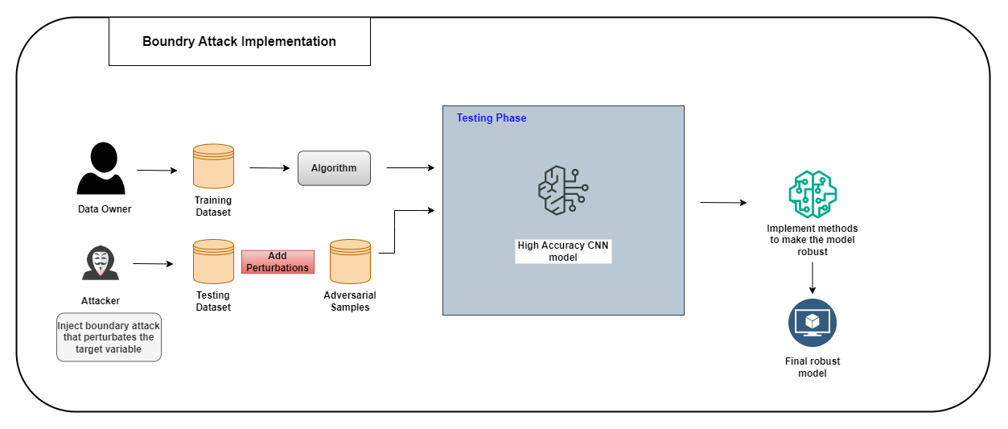
System Diagram
IT21023514 | Karandawala D.N | R24-102

Slide 37






Technologies to be used
Tools and Technologies
Development: Python
Development Environment: Jupyter Notebook and Google Colab
Version Control: GitHub
Algorithm
CNN
Feed Forward Neural Networks
Libraries and Frameworks
Scikit-learn
TensorFlow, Keras
Matplotlib, Numpy, Pandas
ART(Adversarial Robustness Toolbox)
Streamlit
IT21023514 | Karandawala D.N | R24-102

Slide 38

FUNCTIONAL REQUIREMENTS
Ability to identify and evaluate the effect and the accuracy changes of the attack on the CVD prediction model.
Ability to make the model robust by applying a defense mechanism and determining how the model has been made robust.
NON-FUNCTIONAL REQUIREMENTS
Security
Accuracy
Robustness
IT21023514 | Karandawala D.N | R24 -102

Slide 39
Work Breakdown Structure
IT21023514 | Karandawala D.N | R24-102

Slide 40
GANTT CHART
IT21023514 | Karandawala D.N | R24-102

Slide 41
Completion of the project
Task | Details
Dataset | Dataset from kaggle(CVD Cleaned )
Algorithm | CNN
Literature reviews | Decision-Based Adversarial Attacks: Reliable Attacks Against Black-Box Machine Learning Models. BOSH: An Efficient Meta Algorithm for Decision-based Attacks. A Robust Approach to Adversarial Attack on Tabular Data for Classification Algorithm Testing. Poisoning and evasion attacks against deep learning algorithms in Autonomous Vehicles.
External support | Research Rabbit Kaggle
Tools | Jupyter Notebook Google Colab
IT21023514 | Karandawala D.N | R24-102

Slide 42
REFERENCES
[1] W. Brendel, J. Rauber, and M. Bethge, “Decision-Based Adversarial Attacks: Reliable
Attacks Against Black-Box Machine Learning Models.” arXiv, Feb. 16, 2018. [Online]. Available: http://arxiv.org/abs/1712.04248
[2] Z. Xiao, P. Yang, Y. Jiang, K.-W. Chang, and C.-J. Hsieh, “BOSH: An Efficient Meta
Algorithm for Decision-based Attacks.” arXiv, Oct. 14, 2019.
[Online]. Available: http://arxiv.org/abs/1909.04288
[3] L. Ju, R. Cui, J. Sun and Z. Li, "A Robust Approach to Adversarial Attack on Tabular Data for Classification Algorithm Testing," 2022 8th International Conference on Big Data and Information Analytics (BigDIA), Guiyang, China, 2022, pp. 371-376, doi: 10.1109/BigDIA56350.2022.9874200.
[4] Jiang, W. et al. (2020) “Poisoning and evasion attacks against deep learning algorithms in
Autonomous Vehicles,” IEEE Transactions on Vehicular Technology, 69(4), pp. 4439–
4449. Available at: https://doi.org/10.1109/tvt.2020.2977378.‌
‌
‌
IT21023514 | Karandawala D.N | R24-102

Slide 43

IT20172282 |YASUTHTHARA B.G.V
Bachelor of Science (Hons) in Information Technology
Specializing in Cyber Security
IT20172282 | Yasuththara B.G.V | R24-102

Slide 44
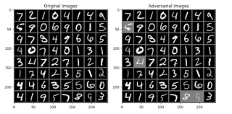
Introduction and Background
Carlini - Wagner (C&W) attack.
Carlini – wagner attack is a white-box adversarial attack.
Crafts imperceptible perturbations to fool machine learning models, specifically neural networks.
IT20172282 | Yasuththara B.G.V | R24-102

Slide 45

Introduction and Background
How the attack works?
It is an optimization-based attack that works by solving an objective function.
The function optimizes perturbation magnitude while maximizing model misclassification confidence.
Uses Adam gradient descent optimization to find minimal perturbations.
Three distance metrics used: L0, L1, and L2 to quantify manipulation.
IT20172282 | Yasuththara B.G.V | R24-102

Slide 46

Research Question
How to attack a disease prediction Model with Tabular data using Carlini Attack?
How to make the Model robust against Carlini Attack?
IT20172282 | Yasuththara B.G.V | R24-102

Slide 47
PROJECT OBJECTIVES
  Main Objective
  Enhance the resilience of the tabular data-based disease prediction model against the Carlini & Wagner (C&W) Attack.
  Sub Objectives
  Protect Business’s disease prediction Model from Carlini Attack which may result in false predictions and lead to monetary loss.
  Develop a neural network for disease prediction with high accuracy and subject it to the Carlini - Wagner (C&W) attack for evaluation.
  Incorporate adversarial training into the model's learning process to discover ways to bolster its defenses.
  Build a system that can analyze a user-provided model for vulnerabilities to attacks and recommend strategies to improve its robustness.
IT20172282 | Yasuththara B.G.V | R24-102

Slide 48
Research Gap
Recent Carlini attack research primarily targets image classification, neglecting tabular data.
No prior efforts have been directed towards making disease prediction models resilient to Carlini attacks.
Implementation of defense mechanisms against Carlini attacks in disease prediction remains unexplored.
IT20172282 | Yasuththara B.G.V | R24-102

Slide 49
Research Gap
 | Topic
Research – A | An Approach to Improve the Robustness of Machine Learning based Intrusion Detection System Models Against the Carlini-Wagner Attack
Research – B | Towards Evaluating the Robustness of Neural Networks
Research – C | Secure and Robust Machine Learning for Healthcare: A Survey
Research – D | Adversarial Machine Learning Attacks against Intrusion Detection Systems: A Survey on Strategies and Defense
Research - E | Adversarial Robust and Explainable Network Intrusion Detection Systems Based on Deep Learning
IT20172282 | Yasuththara B.G.V| R24-102

Slide 50
Research Gap
Research | Using Tabular Data to Train the Model | Making the Model Robust | Carlini Attack | Using a Neural Network Model
Research 1- [1] | ✗ | ✗ | ✓ | ✓
Research 1- [2] | ✗ | ✗ | ✓ | ✓
Research 1- [3] | ✗ | ✗ | ✗ | ✓
Research 1- [4] | ✗ | ✓ | ✗ | ✓
Research 1- [5] | ✗ | ✓ | ✗ | ✗
Disease prediction | ✓ | ✓ | ✓ | ✓
IT20172282 | Yasuththara B.G.V | R24-102

Slide 51

Research Methodology
System Diagram
Technologies
Techniques
Requirements
Work Breakdown Structure / Gantt Chart
IT20172282 | Yasuththara B.G.V | R24-102

Slide 52
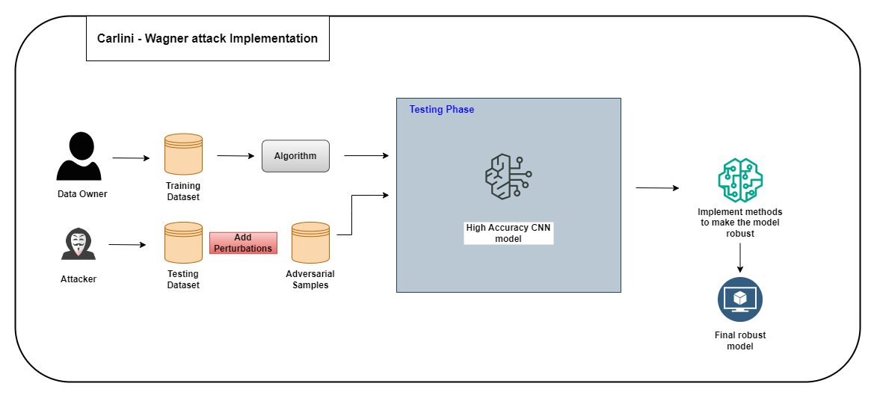
System Diagram
IT20172282 | Yasuththara B.G.V | R24-102

Slide 53
Tools, Technologies and Algorithms
Tools And Technologies
  Development- Python
  Building Model- Jupyter Notebook, Google Colab
  Version Controlling- Github
Algorithm
  Feed-Forward Algorithm
  CNN
Libraries
  Scikit-learn
  Tensor flow,Keras
  Art
  Matplotlib, Numpy, Pandas
  Streamlit
IT20172282 | Yasuththara B.G.V | R24-102

Slide 54
Functional Requirements
Accurately detecting whether the disease prediction Model is being attacked.
Mechanism to make the Robust.
Non Functional Requirements
Security
Reliability
Realtime
Availability
Usability
IT20172282 | Yasuththara B.G.V | R24-102

Slide 55
Work Breakdown Structure
IT20172282 | Yasuththara B.G.V |

Slide 56
Gantt Chart
IT20172282 | Yasuththara B.G.V | R24-102

Slide 57
Completion of the project
Task | Details
Dataset | Dataset from kaggle(CVD Cleaned )
Algorithm | CNN
Literature reviews | An Approach to Improve the Robustness of Machine Learning based Intrusion Detection System Models Against the Carlini-Wagner Attack. Towards Evaluating the Robustness of Neural Networks. Secure and Robust Machine Learning for Healthcare: A Survey. Adversarial Machine Learning Attacks against Intrusion Detection Systems: A Survey on Strategies and Defense. Adversarial Robust and Explainable Network Intrusion Detection Systems Based on Deep Learning.
External support | Research Rabbit Kaggle
Tools | Jupyter Notebook Google Colab
IT20172282 | Yasuththara B.G.V | R24-102

Slide 58
REFERENCES
[1] M. Pujari, B. P. Cherukuri, A. Y. Javaid and W. Sun, "An Approach to Improve the Robustness of Machine Learning based Intrusion Detection System Models Against the Carlini-Wagner Attack," 2022 IEEE International Conference on Cyber Security and Resilience (CSR), Rhodes, Greece, 2022, pp. 62-67, doi: 10.1109/CSR54599.2022.9850306. https://www.researchgate.net/publication/362424253_An_Approach_to_Improve_the_Robustness_of_Machine_Learning_based_Intrusion_Detection_System_Models_Against_the_Carlini-Wagner_Attack
[2] N. Carlini and D. Wagner, "Towards Evaluating the Robustness of Neural Networks," in 2017 IEEE Symposium on Security and Privacy (SP), San Jose, CA, USA, 2017 pp. 39-57.doi: 10.1109/SP.2017.49
https://doi.ieeecomputersociety.org/10.1109/SP.2017.49
[3] A. Qayyum, J. Qadir, M. Bilal, and A. Al-Fuqaha, “Secure and Robust Machine Learning for Healthcare: A Survey,” IEEE Reviews in Biomedical Engineering, vol. 14, pp. 156–180, 2021, doi:
https://doi.org/10.1109/rbme.2020.3013489.https://ieeexplore.ieee.org/stamp/stamp.jsp?arnumber=9153891
[4 ] Evaluating Adversarial Learning on Different Types of Deep Learning-based Intrusion Detection Systems using min-max Optimization ] A. Qayyum, J. Qadir, M. Bilal, and A. Al-Fuqaha, “Secure and Robust Machine Learning for Healthcare: A Survey,” IEEE Reviews in Biomedical Engineering, vol. 14, pp. 156–180, 2021, doi: https://doi.org/10.1109/rbme.2020.3013489.https://ieeexplore.ieee.org/stamp/stamp.jsp?arnumber=9153891
[5] R. Khamis, “Evaluating Adversarial Learning on Different Types of Deep Learning-based Intrusion Detection Systems using min-max Optimization.” Accessed: Jan. 15, 2024. [Online]. Available: https://www.researchgate.net/publication/361541576_Adversarial_Robust_and_Explainable_Network_Intrusion_Detection_Systems_Based_on_Deep_Learning
‌
IT20172282 | Yasuththara B.G.V | R24-102

Slide 59

IT21027642|Bandara W H M T S
Bachelor of Science (Hons) in Information Technology
Specializing in Cyber Security
IT21027642| Bandara W H M T S | R24 - 102

Slide 60
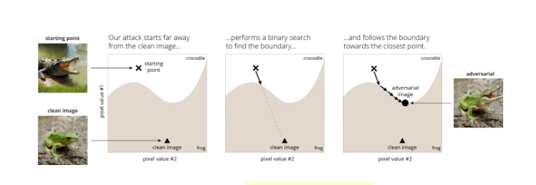
Introduction and Background
Brendel & Bethge attack
This attack shows how making really small changes to input data can confuse these models. especially the ones meant to recognize things in images.(Gradient based approach)
Unlike some other adversarial attack methods, the Brendel & Bethge attack doesn't require an initial adversarial example. Can begin with any correctly classified image.
The attack iterates this process, reducing the perturbation until the image looks almost exactly like the original but is classified as the target misclassification
The main goal of Brendel & Bethge's attack is to find the minimal perturbation path from the original image to an adversarial one
IT21027642 | Bandara W H M T S | R24-102

Slide 61
Introduction and Background
How the attack works?
Instead of starting close to the original image, Brendel & Bethge attack begins far from it, already making it adversarial. This helps in exploring different paths to trick the model.
It then conducts a smart search between this distant starting point and the clean image. This search helps find where the model makes its crucial decisions, known as the decision boundary.
By following the decision boundary, where the model's certainty is lower, the attack bypasses gradient-masking issues. This approach enables it to efficiently find minimal perturbations, improving query-efficiency and robustness evaluation.
IT21027642 | Bandara W H M T S | R24-102

Slide 62
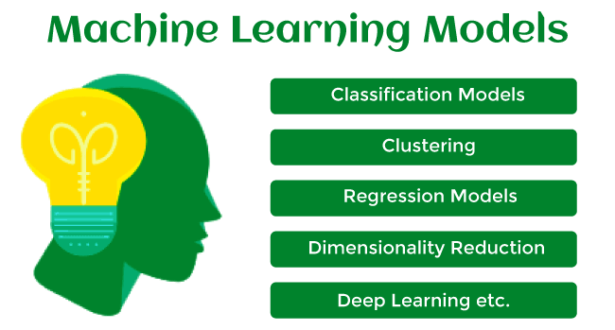
Research Question
How to attack a disease prediction Model with Tabular data using Brendel & Bethge Attack?
How to make the Model robust against Brendel & Bethge Attack?
IT21027642 | Bandara W H M T S | R24-102

Slide 63
Main Objective
  Explore the impact of the Brendel & Bethge attack on disease risk prediction models. By subjecting these models to adversarial attacks, aim to evaluate their reliability and robustness in accurately predicting disease risks.
IT21027642 | Bandara W H M T S | R24-102

Slide 64
Sub Objectives
Enhance the resilience of the tabular data-based disease prediction model against the Brendel & Bethge attack.
Protect Business’s disease prediction Model from Brendel & Bethge Attack which may result in false predictions and lead to monetary loss.
Develop a neural network for disease prediction with high accuracy and subject it to the Brendel & Bethge attack for evaluation.
Incorporate adversarial training into the model's learning process to discover ways to bolster its defenses.
Build a system that can analyze a user-provided model for these attacks and recommend strategies to improve its robustness.
IT21027642 | Bandara W H M T S | R24-102

Slide 65
Research Gap
Recent Brendel & Bethge attack research primarily targets image classification, neglecting tabular data.
No prior efforts have been directed towards making disease prediction models resilient to Brendel & Bethge attacks.
Implementation of defense mechanisms against B&B attacks in disease prediction remains unexplored.
IT21027642 | Bandara W H M T S | R24-102

Slide 66
Research Gap
Research | Using Tabular Data to Train the Model | Making the Model Robust | Brendel & Bethge attack | Using a Neural Network Model
Research A- [1] | ✗ | ✗ | ✓ | ✓
Research B- [2] | ✗ | ✓ | ✗ | ✓
Research C- [3] | ✗ | ✓ | ✓ | ✓
Research D- [4] | ✗ | ✓ | ✗ | ✓
IT21027642 | Bandara W H M T S | R24-102

Slide 67
Research Methodology
System Diagram
Technologies
Techniques
Requirements
Work Breakdown Structure / Gantt Chart
IT21027642 | Bandara W H M T S | R24-102

Slide 68
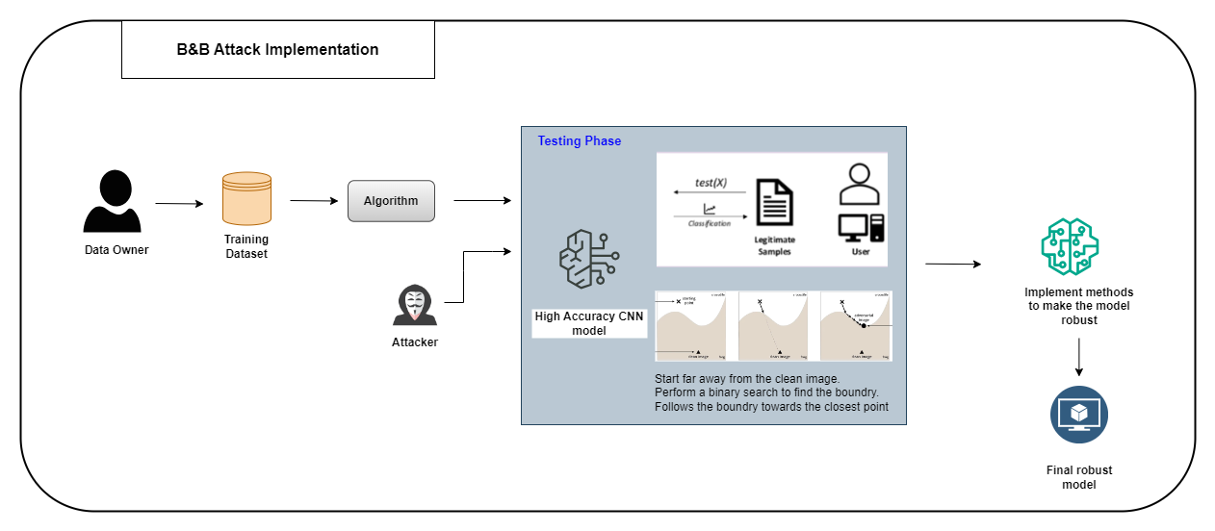
System Diagram
IT21027642 | Bandara W H M T S | R24-102

Slide 69

Tools, Technologies and Algorithms
Tools And Technologies
  Development- Python
  Building Model- Conda Notebook, Google Colab
  Version Controlling- Github
Algorithm
  Feed-Forward Algorithm
  CNN
Libraries
  Scikit-learn
  Tensor flow, Keras
  Art
  Matplotlib, Numpy, Pandas
  Streamlit
IT21027642 | Bandara W H M T S | R24-102

Slide 70
Functional Requirements
Accurately detecting whether the disease prediction Model is being attacked.
Mechanism to make the Robust.
Non Functional Requirements
Security
Reliability
Realtime
Availability
Usability
IT21027642 | Bandara W H M T S | R24-102

Slide 71
Work Breakdown Structure
IT21027642 | Bandara W H M T S | R24-102

Slide 72
Gantt Chart
IT21027642 | Bandara W H M T S | R24-102

Slide 73
Completion of the project
Task | Details
Dataset | Dataset from kaggle(CVD Cleaned )
Algorithm | CNN
Literature reviews | Accurate, reliable and fast robustness evaluation.
External support | Research Rabbit Kaggle
Tools | Jupyter Notebook Google Colab
IT21027642 | Bandara W H M T S | R24-102

Slide 74
References
[1] Brendel, W. (2019, July 1). Accurate, reliable and fast robustness evaluation. arXiv.org. https://arxiv.org/abs/1907.01003
[2] Athalye, A. (2018, February 1). Obfuscated Gradients Give a False Sense of Security: Circumventing Defenses to Adversarial Examples. arXiv.org. https://arxiv.org/abs/1802.00420
[3] Brendel, W. (2017, December 12). Decision-Based Adversarial Attacks: Reliable Attacks Against Black-Box Machine Learning Models. arXiv.org. https://arxiv.org/abs/1712.04248
[4] Madry, A. (2017, June 19). Towards Deep Learning Models Resistant to Adversarial Attacks. arXiv.org. https://arxiv.org/abs/1706.06083
IT21027642 | Bandara W H M T S | R24-102

Slide 75

Commercialization
Our proposed system will allow healthcare organizations to test their Heart disease prediction models against the PGD, Carlini, Brendel, and Boundary attacks.
This system will allow organizations with various domains to check their models robustness against these attacks.
Quick assessment of whether the model can resist these attacks.
Provide suggestions to healthcare organizations to build safe and strong disease prediction models.
Identifying if attacks can harm users’ models before those attacks happen will help to ensure cost-effectiveness and increase the efficiency of the model.

Slide 76

Questions?

Slide 77
THANK YOU!

