Slide 1

Enhancing and Developing Adversarial Robustness of Diseases Risk Predictors Against Multiple Adversarial Attacks.
PROJECT ID : R24-102

Slide 2

Team Members
Supervisor – Ms. Chethana Liyanapathirana
Co-Supervisor – Mr. Deemantha Siriwardana
Student Name | Student ID
Karandawala D.N | IT21023514
Yasuththara B.G.V | IT20172282
Weerakoon R. A. D. D. C | IT21068164
Bandara W H M T S | IT21027642

Slide 3
CONTENT
INTRODUCTION AND BACKGROUND
RESEAECH PROBLEM
PROJECT OBJECTIVES
RESEARCH COMPONENTS AND NOVELTY
MEETING STATUS

Slide 4
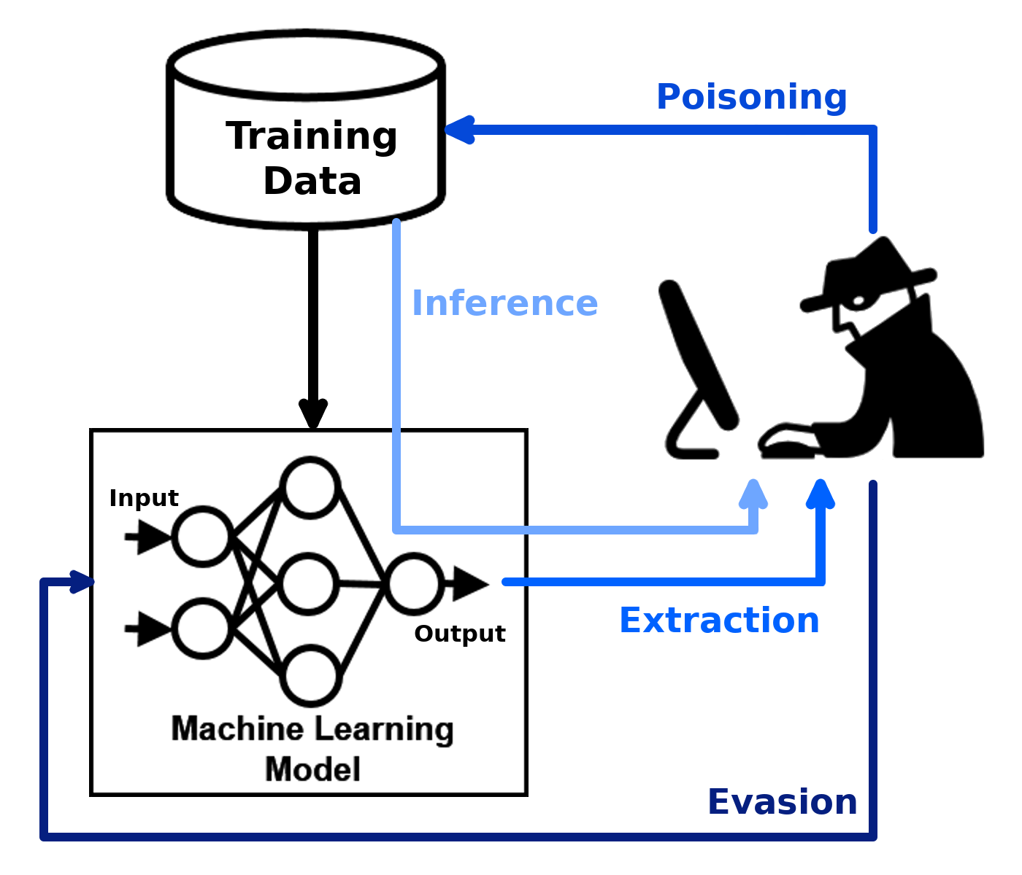
Introduction
Disease risk prediction models are vulnerable to adversarial attacks that add perturbations, inject noise, or manipulate features.
Developing defenses against a wide range of adversarial techniques is crucial for reliability and effectiveness in real-world settings.
Strategies like adversarial training, improved feature selection, and advanced anomaly detection can enhance model resilience.
Assessing impact of attacks on different disease types provides insights into vulnerabilities.
Evaluating generalizability of defenses across healthcare datasets is important to ensure robustness.

Slide 5
Introduction
In this context, we are attempting to demonstrate the effects of four kinds of adversarial attacks namely Boundary Attack, Project Gradient Descent Attack, Carlini Attack, and Brendel-Bethge attack on a disease prediction model. i.e. Cardiovascular disease prediction(CVD).
CVD Prediction: To detect whether a person is suffering from a cardiovascular disease by considering certain attributes.
Notes:
Attributes like :
Chest pain, cholesterol level, age of the person, and some other attributes.

Slide 6

Research problem
How can we make our model robust against these adversarial attacks?
What are the defense mechanisms that can we apply to make the model robust?

Slide 7

Main Objective
To assess the effect of the above mentioned adversarial attacks on a disease prediction model and attempt to increase model strength against the given attacks.

Slide 8
Sub Objective
Build a neural network model with high accuracy for a cardiovascular disease dataset.
Apply the adversarial attacks against the model and identify accuracy changes.
Evaluate the extent to which the attack affects the model by comparing the accuracies.
Identify and test defense mechanisms to make the model robust against the said attacks.
Build a system that allows a user to input a model that will be tested against the attack and suggest methods to make the mold robust if the model is affected.

Slide 9

RESEARCH COMPONENT & NOVELTY
Introduction and Background
Carlini - Wagner (C&W) attack.
Carlini – wagner attack is a white-box adversarial attack.
Crafts imperceptible perturbations to fool machine learning models, specifically neural networks.
One of the most effective attacks against defensive distillation, a technique used to make models more robust.
IT20172282 | Yasuththara B.G.V | R24-102

Slide 10

RESEARCH COMPONENT & NOVELTY
How the attack works?
It is an optimization-based attack that works by solving an objective function.
The function optimizes perturbation magnitude while maximizing model misclassification confidence.
Uses Adam gradient descent optimization to find minimal perturbations.
Three distance metrics used: L0, L1, and L2 to quantify manipulation.
IT20172282 | Yasuththara B.G.V | R24-102

Slide 11

RESEARCH COMPONENT & NOVELTY
Why test Carlini - Wagner attack on disease risk prediction models?
  The goal of a Carlini attack is to find the smallest perturbation to the input data that can cause the model to misclassify a patient’s disease prediction, thereby leading to inaccurate predictions about their disease.
  This will highly impact the patient’s life with the wrong prediction of the disease if the model is sensitive to Carlini attack.
IT20172282 | Yasuththara B.G.V | R24-102

Slide 12
NOVELTY
Apply the Defense Distillation mechanism to the disease prediction model to reduce its vulnerability to Carlini attack.
  Teacher-student setup with clean data and soft probability labels.
  Learning from soft probabilities smoothens decision boundaries.
  Evaluation against Carlini attacks to measure defense effectiveness.
  Focus on improved accuracy against manipulated test data.
  Assessing if distillation leads to a more robust model against adversarial attacks.
  Emphasis on decision boundary resilience and enhanced accuracy.
IT20172282 | Yasuththara B.G.V | R24-102

Slide 13
NOVELTY
Apply an Input randomization and reconstruction mechanism to the disease prediction model to reduce its vulnerability to Carlini attack.
  Incorporate input randomization during model training.
  Reconstruct original input from internal model representations.
  Compare reconstructed input to actual received input during training.
  Identify significant discrepancies as potential indicators of input manipulation.
  Specifically assess resistance to Carlini attacks for enhanced model security.
IT20172282 | Yasuththara B.G.V | R24-102

Slide 14
REFERENCES
[1] M. Pujari, B. P. Cherukuri, A. Y. Javaid and W. Sun, "An Approach to Improve the Robustness of Machine Learning based Intrusion Detection System Models Against the Carlini-Wagner Attack," 2022 IEEE International Conference on Cyber Security and Resilience (CSR), Rhodes, Greece, 2022, pp. 62-67, doi: 10.1109/CSR54599.2022.9850306.
[2] A. Qayyum, J. Qadir, M. Bilal, and A. Al-Fuqaha, “Secure and Robust Machine Learning for Healthcare: A Survey,” IEEE Reviews in Biomedical Engineering, vol. 14, pp. 156–180, 2021, doi: https://doi.org/10.1109/rbme.2020.3013489.https://ieeexplore.ieee.org/stamp/stamp.jsp?arnumber=9153891
[3] R. Khamis, “Evaluating Adversarial Learning on Different Types of Deep Learning-based Intrusion Detection Systems using min-max Optimization.” Accessed: Jan. 15, 2024. [Online]. Available: https://web.archive.org/web/20201114140318id_/https://curve.carleton.ca/system/files/etd/3bec2df2-800c-4a66-a13d-db790c7e68eb/etd_pdf/68d49d09b005b5a0053ca351d103b711/aboukhamis-evaluatingadversariallearningondifferenttypes.pdf
[4] Liang, H.; He, E.; Zhao, Y.; Jia, Z.; Li, H. Adversarial Attack and Defense: A Survey. Electronics 2022, 11, 1283. https://doi.org/10.3390/electronics11081283
[5] “Machine Learning Security: Threats, Countermeasures, and Evaluations | IEEE Journals & Magazine | IEEE Xplore.” https://ieeexplore.ieee.org/document/9064510 (accessed Jan. 05, 2024).
IT20172282 | Yasuththara B.G.V | R24-102

Slide 15
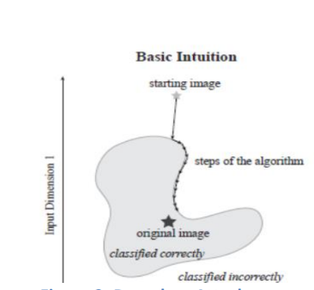
Introduction and Background
RESEARCH COMPONENT & NOVELTY
Boundary Attack(BA)
It is a black box evasion attack.
Decision Base Attack- Perturbations are made to the target variable.
BA algorithm is initialized at an adversarial example and gradually moves closer to the accurately classified example.
IT21023514 | Karandawala D.N | R24-102

Slide 16
RESEARCH COMPONENT & NOVELTY
How does the Boundary Attack affect Disease Risk Prediction?
The attack will perturbate the target variable in a way that cannot identified to humans. When the model is built, these perturbations will cause misclassification which will result in wrong patient disease predictions. This will lead to wrong treatments for the patients.
IT21023514 | Karandawala D.N | R24-102

Slide 17
RESEARCH COMPONENT & NOVELTY
Why test Boundary attack on disease risk prediction models?
  The goal of a boundary attack is to perturbate the target variable that can cause the model to misclassify a patient’s disease prediction, thereby leading to inaccurate predictions about their disease.
  This will highly impact the patient’s life with the wrong prediction of the disease if the model is sensitive to boundary attack.
IT21023514 | Karandawala D.N | R24-102

Slide 18
NOVELTY
Apply the Adversarial training mechanism to the disease prediction model to reduce its vulnerability to Boundary attack.
Adversarial training generates adversarial examples at boundaries of allowable input values to improve robustness against attacks. This strengthens cybersecurity by anticipating malicious perturbations.
Retraining the model with adversarial examples exposes it more to abnormal cases and extremes in the data distribution. This enhances the model's defenses.
Optimization using both clean and adversarial data makes the model less sensitive to perturbations at input distribution edges. This improves resilience against cyber attacks aiming to cause misdiagnosis.
Adversarial training acts as regularization to smooth out decision boundaries. This makes the model's predictions more stable in the presence of malicious perturbations, strengthening cybersecurity.
IT21023514 | Karandawala D.N | R24-102

Slide 19
NOVELTY
Apply the Density estimation mechanism to the disease prediction model to reduce its vulnerability to Boundary attack.
Identify and flag anomalous outliers that could be adversarial.
IT21023514 | Karandawala D.N | R24-102

Slide 20
References
[1] Jiang, W. et al. (2020) “Poisoning and evasion attacks against deep learning algorithms in
Autonomous Vehicles,” IEEE Transactions on Vehicular Technology, 69(4), pp. 4439–
4449. Available at: https://doi.org/10.1109/tvt.2020.2977378.‌
[2] Alrasheedi, F. and Zhong, X. (2023) Imperceptible adversarial attack on deep neural networks from image boundary, arXiv.org.
Available at: https://arxiv.org/abs/2308.15344 (Accessed: 10 January 2024).
[3] Liang, H.; He, E.; Zhao, Y.; Jia, Z.; Li, H. Adversarial Attack and Defense: A Survey. Electronics 2022, 11, 1283. https://doi.org/10.3390/electronics11081283
[4] “Machine Learning Security: Threats, Countermeasures, and Evaluations | IEEE Journals & Magazine | IEEE Xplore.” https://ieeexplore.ieee.org/document/9064510 (accessed Jan. 05, 2024).
‌
‌
IT21023514 | Karandawala D.N | R24-102

Slide 21
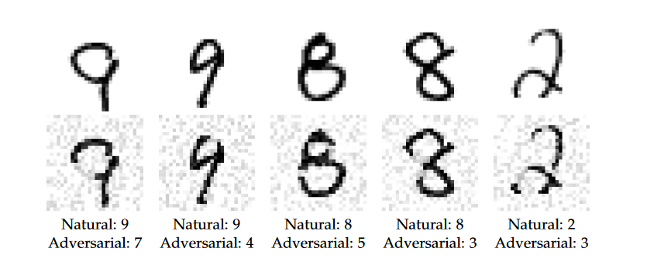
Introduction and Background
RESEARCH COMPONENT & NOVELTY
Projected Gradient Descent(PGD) Attack.
Apply project gradient descent attack on a structured cardiovascular dataset.
It is a White box adversarial attack.
Utilize gradient descent for iterative model deception
Begin with a random perturbation in the LP ball.
IT21068164 | Weerakoon R. A. D. D. C | R24-102

Slide 22
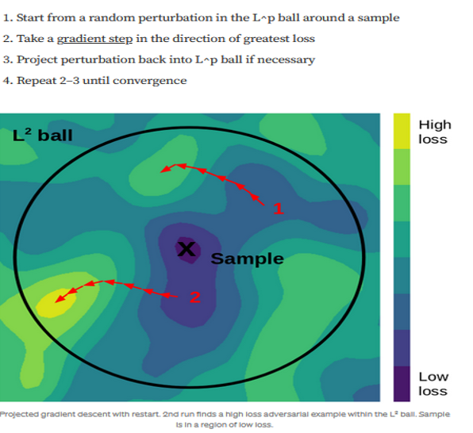
Introduction and Background
Co-concept Gradient descent
Popular optimization technique in ML.
Minimizes loss function by adjusting model parameters.
Significance for decision making
Highlight the sensitivity of the model to PGD attack
Emphasize potential consequences for managing cardiovascular risks.
PGD attacks are versatile and can be applied to different domains.
IT21068164 | Weerakoon R. A. D. D. C | R24-102

Slide 23
RESEARCH COMPONENT & NOVELTY
Why test PGD attacks on disease risk prediction models?
  The goal of a PGD attack is to perturbate the target variable that can cause the model to misclassify a patient’s disease prediction, thereby leading to inaccurate predictions about their disease.
  This will highly impact the patient’s life with the wrong prediction of the disease if the model is sensitive to PGD attack.
IT21068164 | Weerakoon R. A. D. D. C | R24-102

Slide 24
NOVELTY
Apply the Gradient Regularization mechanism to the disease prediction to reduce its vulnerability to PGD attack.
• Penalize significant feature changes during training.
• Reduce model reliance on sensitive features.
• Adjust learning to discourage feature overreliance.
• Test on normal/manipulated data for resilience.
IT21068164 | Weerakoon R. A. D. D. C | R24-102

Slide 25
NOVELTY
Apply the Certified Defenses mechanism to disease prediction to reduce its vulnerability to PGD attack.
• Formally verify robustness against perturbations.
• Certified defense within a specified epsilon radius.
• Use formal verification during training.
• Test model against perturbed inputs in defined norm ball
IT21068164 | Weerakoon R. A. D. D. C | R24-102

Slide 26
References
[1]
Y. Jiang, G. Yin, Y. Yuan, and Q. Da, “Project Gradient Descent Adversarial Attack against Multisource Remote Sensing Image Scene Classification,” Security and Communication Networks, vol. 2021, pp. 1–13, Jun. 2021, doi: 10.1155/2021/6663028.
[2]
M. S. Ayas, S. Ayas, and S. M. Djouadi, “Projected Gradient Descent Adversarial Attack and Its Defense on a Fault Diagnosis System,” in 2022 45th International Conference on Telecommunications and Signal Processing (TSP), Jul. 2022, pp. 36–39. doi: 10.1109/TSP55681.2022.9851334.
[3]
Y. Jiang, G. Yin, Y. Yuan, and Q. Da, “Project Gradient Descent Adversarial Attack against Multisource Remote Sensing Image Scene Classification,” Security and Communication Networks, vol. 2021, p. e6663028, Jun. 2021, doi: https://doi.org/10.1155/2021/6663028.
[4]
“I-PGD-AT: EFFICIENT ADVERSARIAL TRAINING VIA IMITATING ITERATIVE PGD ATTACK.” Accessed: Jan. 15, 2024. [Online]. Available: https://openreview.net/pdf?id=TEt7PsVZux6
[5]
“Machine Learning Security: Threats, Countermeasures, and Evaluations | IEEE Journals & Magazine | IEEE Xplore.” https://ieeexplore.ieee.org/document/9064510 (accessed Jan. 05, 2024).
IT21068164 | Weerakoon R. A. D. D. C | R24-102

Slide 27
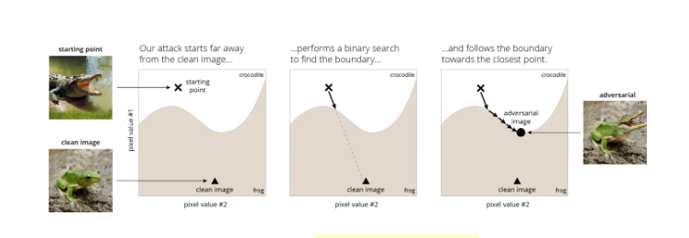
RESEARCH COMPONENT & NOVELTY
Introduction and Background
Brendel & Bethge attack
The Brendel & Bethge attack shows how making really small changes to input data can confuse these models, especially the ones meant to recognize things in images.
Brendel & Bethge is a type of adversarial attack, where they mess with pictures to make the model make mistakes, especially in figuring out what's in the picture.
White-Box Approach (Requires detailed knowledge of the target model.)
The main goal of Brendel & Bethge's attack is to make tiny changes to input data that fool one specific ML model.
IT21027642 | Bandara W H M T S | R24-102

Slide 28
RESEARCH COMPONENT & NOVELTY
How the attack works?
The attack makes small, tricky adjustments to the input data. These changes are carefully designed to confuse the ML model, into making mistakes in what it sees.
Once the tricky changes are made, they're tested on various types of computer programs that recognize things in images.
The attack takes advantage of things that many computers have in common, like shared vulnerabilities or features. This reveals potential weaknesses in how these computers process data, making them susceptible to the same trick.
IT21027642 | Bandara W H M T S | R24-102

Slide 29
RESEARCH COMPONENT & NOVELTY
Why test Brendel & Bethge attack on disease risk prediction models?
  Testing the Brendel & Bethge attack on disease risk prediction models helps assess how reliable these models are. By finding the smallest changes that can mislead the model, it reveals potential vulnerabilities. If the model is sensitive to these attacks, it raises concerns about its accuracy in predicting disease risks.
  The potential for inaccurate predictions due to the Brendel & Bethge attack has significant real-world consequences. Patients may receive incorrect information about their disease risks, leading to unnecessary stress, treatments, or neglect of actual health issues. Understanding the impact on patients' lives emphasizes the importance of building robust and secure disease prediction models.
IT21027642 | Bandara W H M T S | R24-102

Slide 30
NOVELTY
Apply Adversarial Training Mechanism and Gradient Obscuration mechanisms to the disease prediction model to reduce its vulnerability to Brendel - Bethge attack.
Modify the training process of a Cardiovascular disease prediction model to reduce vulnerability to Brendel & Bethge attack.
Introduce adversarial training to enhance model robustness against adversarial examples.
Incorporate gradient obscuration mechanisms during training to minimize model susceptibility to adversarial manipulations.
IT21027642 | Bandara W H M T S | R24-102

Slide 31
References
[1] Zhang, D., & Yang, D. (2023, October 1). Adv-BDPM: Adversarial attack based on Boundary Diffusion Probability Model. Neural Networks. https://doi.org/10.1016/j.neunet.2023.08.048
[2] Luo, T., Zhong, Y., & Khoo, S. (2023, January 1). ExploreADV: Towards exploratory attack for Neural Networks. arXiv (Cornell University). https://doi.org/10.48550/arxiv.2301.01223
[3] “Machine Learning Security: Threats, Countermeasures, and Evaluations | IEEE Journals & Magazine | IEEE Xplore.” https://ieeexplore.ieee.org/document/9064510 (accessed Mar. 31, 2023).
[4] Liang, H.; He, E.; Zhao, Y.; Jia, Z.; Li, H. Adversarial Attack and Defense: A Survey. Electronics 2022, 11, 1283. https://doi.org/10.3390/electronics11081283
IT21027642 | Bandara W H M T S | R24-102

Slide 32
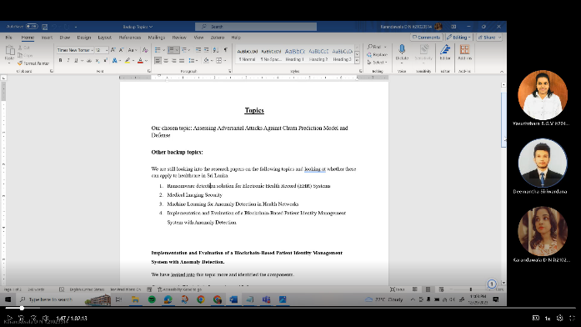
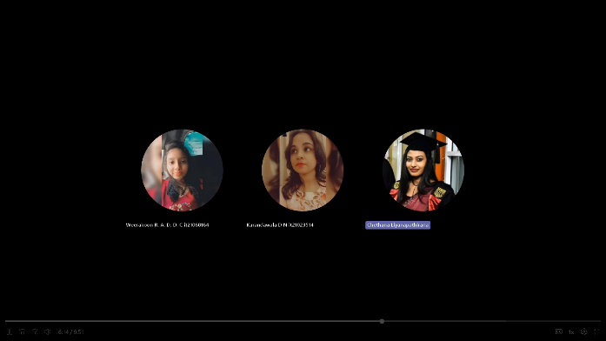


Meeting Status
Number of meetings with the supervisor / Co - supervisor | 6
Number of meetings among the team | 15
#1
#2
#3
#4

Slide 33

Questions?

Slide 34
THANK YOU

